Slide 1
Clinical Decision Support and Cervical Cancer Screening and Management: Environmental Scan
18 December 2020 (Updated on 2/12/21)
The Health FFRDC, on behalf of:
Centers for Disease Control and Prevention National Center for Chronic Disease Prevention and Health Promotion Division of Cancer Prevention and Control
Approved for Public Release; Distribution Unlimited.​
Public Release Case Number 22-0881

Slide 2
Environmental Scan
Purpose
Investigate existing clinical practice guidelines, quality measures, and electronic health record (EHR) capabilities in the domain of cervical cancer screening and management
Objectives
In-depth review of guidelines for cervical cancer screening and management (CCSM)
Assess current implementations of clinical decision support (CDS) in health information technology (IT) systems
Identify clinician-preferred screening and management workflows
Understand elements of current workflow that could be enhanced by new CDS tools

Slide 3
Table of Contents
Project and Environmental Scan Overview: Provides a “big picture” overview of the Cervical Cancer CDS project and environmental scan
Key Environmental Scan Themes: Lists themes emerging from the environmental scan and their relevance to potential CDS designs
Detailed Findings: Supplies in-depth detail across eight components of the environmental scan
Evidence Review
Current Clinical Practices
Patient Experiences
EHR and Related Capabilities
Anatomic Pathology & Laboratory Information Systems
Information Standards
Quality Measurement
Existing Tools
References: List of references cited in this document

Slide 4
Project and Environmental Scan Overview

Slide 5
Introduction
Project Goals
Develop CDS to enable improved adherence to advances in cervical cancer screening and management guidelines
Encourage awareness, adoption, and application of the most up-to-date cervical cancer screening guidance and new risk-based approach for managing abnormal outcomes and disease
Environmental Scan Rationale
Purpose is to inform CDS development
Multiple sources of information reviewed and analyzed:
Guidelines, standards, and evidence-based research
Interviews with experts and other stakeholders
Publicly available source code and application programming interfaces (APIs)

Slide 6
Cervical Cancer Screening & Management
14,480 new cervical cancer cases and 4,290 estimated deaths anticipated in 2021
In 2016, an estimated 196,000 total cases of CIN2+, with 43% attributed to HPV 16/18
Cervical cancer is preventable and disproportionately affects underserved populations
Problem
Priorities
Increase guideline adoption:
Screening
Management
Reduce health disparities
Clinical workflow alignment
Challenges
Multiple screening options
Risk-based guidelines harder to apply
Unstructured data
Fractured EHR and laboratory information system (LIS) market
Opportunities
Health IT standards
21st Century Cures Act
Adapting Clinical Guidelines for the Digital Age initiative
Agency for Healthcare Research and Quality CDS Connect project
Clinical Decision Support ▪︎ Interoperable tools to facilitate application of guidelines.

Slide 7
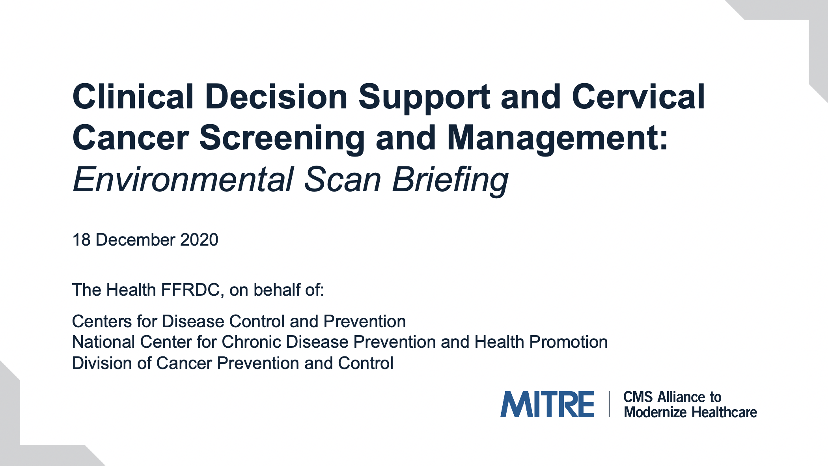
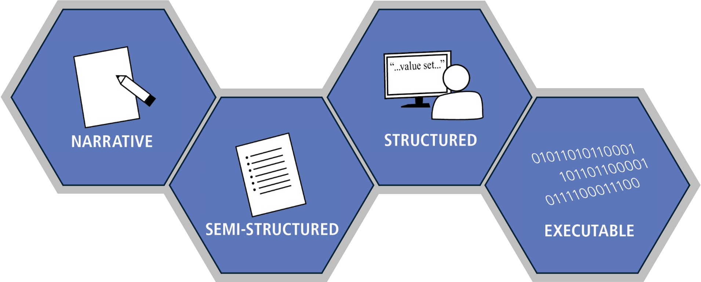

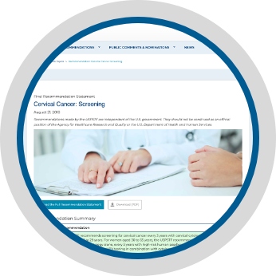
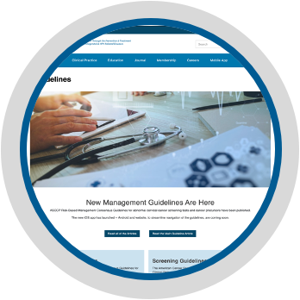





Clinical Decision Support (CDS) Development
Adapted from: M. Michaels, Adapting Clinical Guidelines for the Digital Age, 5 Jan 2021
Environmental Scan
Environmental scan informs multiple stages of CDS development
Guidelines
Feedback from clinical pilots
Health IT Standards & Terminologies

Slide 8
Project Timeline
Currently in Year 1 of a multi-year effort to develop CDS tools to support clinician adherence to advances in screening and management of cervical cancer
Define CDS
(Year 1)
Pilot CDS
(Year 2)
Adoption
(Year 3)
Environmental scan
CDS Definitions
Test fixtures & software
Pilot partner(s)
Implementation guides
Integration with electronic health record (EHR)
Quantified CDS effectiveness
Quality Measures
(Years 2 & 3)
Companion electronic clinical quality measures (eCQM)
Communication
Dissemination
Sharing
Messaging
Updates

Slide 9
Environmental Scan: Components
Evidence Review
The environmental scan consists of eight components
Use diagram to navigate to details
For details of each component:
Findings are summarized
Sources are listed
Gaps / needs are highlighted
The Key Environmental Scan Themes section provides a high-level summary and distillation of findings from environmental scan
Existing Tools
Current Clinical Practices
Quality Measurement
Environmental
Scan
Patient Experiences
Information Standards
EHR and Related Capabilities
Anatomic Pathology & Laboratory Information Systems

Slide 10
Key Environmental Scan Themes

Slide 11
Cervical Cancer Screening and Management Lifecycle
Routine Screening
Lab Testing
Communicate Results to Provider & Patient
Follow-Up Management
Lifecycle model distilled from environmental scan findings
It provides context to findings and helps highlight key takeaways
Three underlying themes have been identified
Screening for High-Risk Populations
Lifecycle model
Exit Criteria
Entry Criteria
Negative Screening /
Average Risk Populations
Management
of Positive Screenings

Slide 12
Underlying Themes Extracted from Detailed Findings
Data
Decisions
Directions
What data is needed to apply the guidelines?
What decisions must be made and by whom?
How can CDS facilitate application of the guidelines?
The next three slides depict these themes in the context of the lifecycle

Slide 13

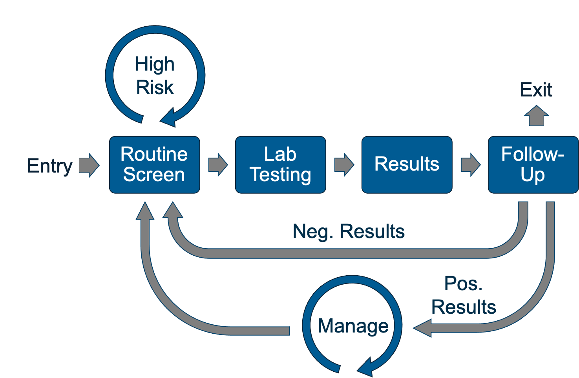


Data: What data are needed to apply the guidelines?
MEDICAL HISTORY
Age, sex
Demographics
Immunocompromised
HPV vaccination
CYTOLOGY, HPV TESTING, or COTESTING
Likely unstructured
No widespread data standards
Do people conducting these tests have awareness of the guidelines?
Likely structured
COLPOSCOPY & BIOPSY
Likely unstructured
PATIENT PREFERENCES
Checklists exist but you still may just get a pdf
Data standards are actively evolving (watch this space)
How to frame results in context of guidelines?
OTHER PROCEDURES
Hysterectomy
Treatments (e.g., ablation)
Possibly structured

Slide 14

Decisions: What decisions must be made and by whom?
When should I be screened?
Were the appropriate tests ordered?
Is reflex testing needed?
Patients
How can I best capture and format the pathology results?
What do the test results mean?
Pathologists
What are the risk implications of the pathology results?
Which patients are due for screening?
How do I apply guidelines with missing data?
What is my patient’s medical history?
Do I need to order follow-up tests or expedited treatment?
Which screening type is right for my patient?
Clinicians
Clinicians

Slide 15

Directions: How can CDS facilitate application of the guidelines?
Provide education and context:
Screening importance
Test result implications
PATIENT FACING
LABORATORY FACING
Encourage structured data capture for tests
Can’t assume data will be easily interpretable
Use guidelines to provide context:
Test appropriateness
Test interpretability
Shared decision-making
Make it easier to view pertinent patient history in one place
Make it easier to review lab & pathology data
Provide tools to facilitate application of guidelines
Frame patient history in the context of the guidelines
CLINICIAN FACING

Slide 16
Conclusions
Data
Management requires data that is typically stored in an unstructured format which is hard for computers to interpret.
Natural Language Processing (NLP) algorithms exist but are not a mature technology in this area.
Decisions
Choice of screening approach influenced by guidelines, testing availability, patient preferences, and provider culture.
Management relies on risk model for determining best course of action for patient.
Directions
Management guideline is complex and requires computer assistance to implement.
Ensuring required data is recorded in a structured format promises a more robust solution.
Risk model may require information from multiple medical professionals (clinician, pathologist, colposcopist).
Algorithms are not a substitute for clinicians and cannot easily take patient preferences into consideration.
CDS should make applying the management guideline less complex and provide context of recommendations for both clinician and patient.

Slide 17
Detailed Findings

Slide 18
Environmental Scan Components
Evidence Review
The environmental scan consists of eight components
Use diagram to navigate to details
For each component:
Findings are summarized
Sources are listed
Gaps / needs are highlighted
Existing Tools
Current Clinical Practices
Quality Measurement
Environmental
Scan
Patient Experiences
Information Standards
EHR and Related Capabilities
Anatomic Pathology & Laboratory Information Systems

Slide 19
Evidence Review
Return to Navigation
Evidence Review
“Clinical practice guidelines are systematically developed statements to assist practitioner and patient decisions about appropriate health care for specific clinical circumstances.” (Institute of Medicine, 1990)
CCSM guidelines exist for:
Asymptomatic, average risk individuals
Immunocompromised populations
Management of abnormal test results
Existing Tools
Current Clinical Practices
Quality Measurement
Environmental
Scan
Patient Experiences
Information Standards
EHR and Related Capabilities
Anatomic Pathology & Laboratory Information Systems

Slide 20
Evidence Review: Key Takeaways
Cervical cancer prevention strategies have evolved over the last 20 years, driven by:
Advanced understanding of HPV as causal factor
Availability of HPV vaccines and HPV tests
Data providing personalized cervical precancer risk
Current cervical cancer screening guidelines recommend:
Initiating screening at age 21-25 through age 65 for asymptomatic individuals with a cervix
Options of cytology testing only, primary HPV testing, or co-testing (cytology and HPV testing)
Modified screening guidelines exist for symptomatic, immunocompromised populations
Management of abnormal screening results based on precancer risk and can include more frequent screening, colposcopy, or expedited treatment

Slide 21
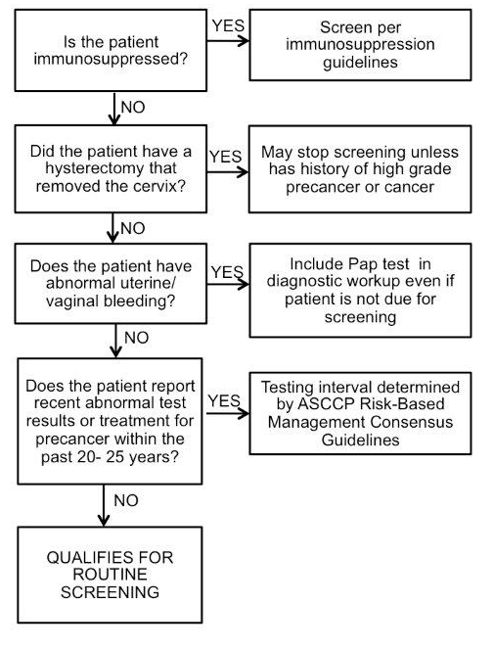
Evidence Review: Cervical Cancer Screening Eligibility
Determining eligibility for
routine screening
Evidence Based
Guideline
Guidelines for the Prevention and Treatment of Opportunistic Infections in Adults and Adolescents with HIV (2019)
Guidelines for Cervical Cancer Screening in Immunosuppressed Women Without HIV Infection (2019)
ASCCP Cervical Cancer Management Guidelines (2018)
USPSTF Cervical Cancer Screening Guidelines (2018)
American College of Obstetricians and Gynecologists (2016)
American Cancer Society (2020)
Figure from Perkins et al. (2020)

Slide 22
Evidence Review: Guidelines for Cervical Cancer Screening

Slide 23
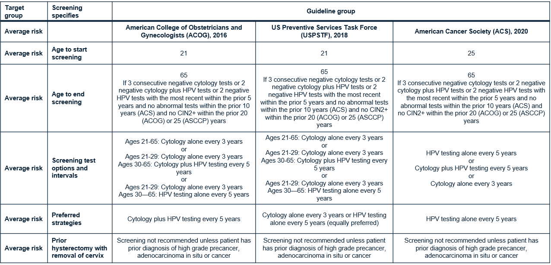
Cervical Cancer Screening for Asymptomatic, Average Risk Individuals
(Other target groups include individuals immunocompromised by HIV infection and individuals with a diagnosis of CIN2+ within the prior 25 years)

Slide 24
CCSM for Adults and Adolescents with HIV Infection <30-year-old [71]
Guidelines for the Prevention and Treatment of Opportunistic Infections in Adults and Adolescents with HIV (2020)
https://clinicalinfo.hiv.gov/sites/default/files/guidelines/documents/Adult_OI.pdf
Screening recommendation:
< 21-year-old with HIV infection
Cervical cancer (CC) screening should commence within 1 year of sexual activity regardless of mode of HIV transmission
21 to 29-year-old with HIV infection
Pap test should be performed at time of initial diagnosis with HIV then repeated every 12 months.
After 3 consecutive Pap tests with normal results, follow-up Pap should be every 3 years.
Co-testing not recommended for women with HIV infection <30 years of age.

Slide 25
CCSM for Adults and Adolescents with HIV Infection ≥30-year-old [71]
Guidelines for the Prevention and Treatment of Opportunistic Infections in Adults and Adolescents with HIV (2020)
https://clinicalinfo.hiv.gov/sites/default/files/guidelines/documents/Adult_OI.pdf
Screening recommendation:
Pap test should be performed at time of initial diagnosis with HIV then repeated every 12 months.
If co-testing available, co-testing can be performed at baseline HIV diagnosis or at age of 30 then repeated every 3 years.
After 3 consecutive Pap tests with normal results, follow-up Pap should be every 3 years.

Slide 26
CCSM for Immunosuppressed Women Without HIV Infection [72] (1 of 2)
Applies to the following populations:
Solid Organ Transplant recipients
Hematopoietic Stem Cell Transplant (HSCT) patients
Irritable Bowel Disease (IBD) on immunosuppressive treatments
Systemic Lupus Erythematosus (SLE) on immunosuppressive treatments
Rheumatoid Arthritis (RA) on immunosuppressive treatments
Cervical Cancer Screening Recommendations
Follow guidelines for Guidelines for the Prevention and Treatment of Opportunistic Infections in Adults and Adolescents with HIV
For HSCT patients who develop a new diagnosis of genital graft vs host disease (GvHD) or chronic GvHD, follow either of the below options –
Resume annual cervical cytology until 3 consecutive normal results, then transition to cytology every 3 years
Perform an initial baseline co-test, and, if cytology is normal and HPV is negative, perform co-testing every 3 years.
Continue screening throughout lifetime (older than 65 years). Discontinue screening based on shared discussion regarding quality and duration of life rather than age.

Slide 27
CCSM for Immunosuppressed Women Without HIV Infection [72] (2 of 2)
With IBD, SLE, or RA not on immunosuppressive treatments, follow screening guidelines for general populations
With Diabetes Mellitus, follow screening guidelines for general populations

Slide 28
Evidence Review: Guidelines for Management of Abnormal Cervical Cancer Screening Results

Slide 29
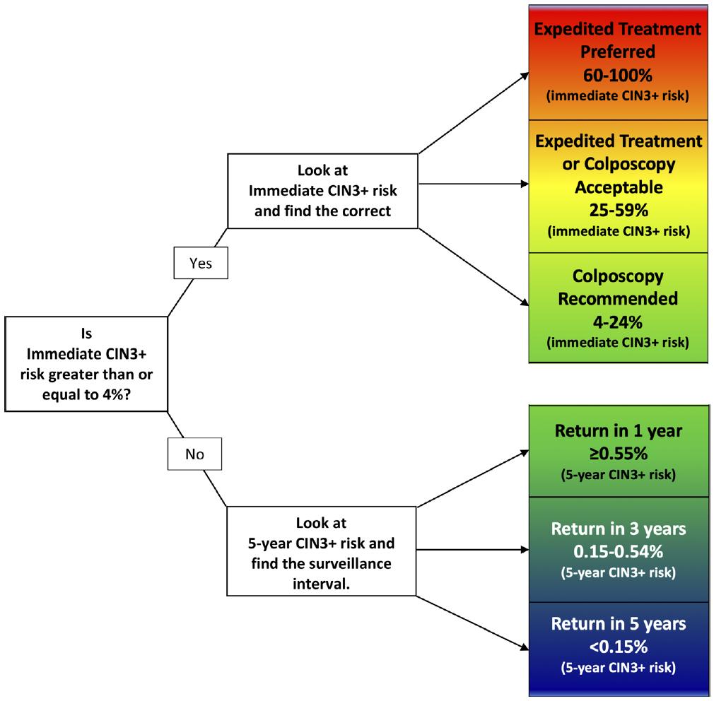
Management of Abnormal Screening Results [73]
6 Clinical Actions to Manage Abnormal Results
ASCCP Management Guidelines
Risk Estimate and Management Tables Based on 5 Clinical Scenarios listed below, leading to a recommendation based on 6 Clinical Actions shown in the figure
Current abnormal screening results
Surveillance of past screening results not requiring immediate colposcopic referral
Management based on colposcopy/biopsy results
Postcolposcopy surveillance after less than CIN 2 histology
Posttreatment follow-up
Figure from: Summary of ASCCP Risk-Based management Consensus Guidelines from Perkins et al. (2020)
29

Slide 30
ASCCP Management Guidelines
2019 American Society for Colposcopy and Cervical Pathology (ASCCP) Management Guidelines [73]
ASCCP provides free use of web-based application (https://app.asccp.org/) and a mobile app for purchase
Risk Estimate and Management Tables are publicly available (https://cervixca.nlm.nih.gov/RiskTables/)
NCI Interview [I-2]
The architecture in place through the enduring guidelines effort should be stable for next decade. This means that risk thresholds are not expected to change and were developed from the start so new technologies can be introduced with only back-end programming changes.
Except for the images themselves, the NCI-developed educational resources are public domain and free to incorporate into a publicly available CDS
The risk model allows for unknown data and does not falter if past test results are not available
Even with the advent of HPV screening and vaccination, cytology is taking on more of a diagnostic role. Still very important to maintain sensitivity of cytology to use in this application [43].

Slide 31
ASCCP Management Guidelines [73]
Risk based guidelines based on immediate and 5-year risk for CIN3+
If immediate risk of CIN3+ is <4%, refer to 5-year risk of CIN3+ for follow-up testing timeframe
If immediate risk of CIN3+ is ≥ 4%, use immediate CIN3+ risk to determine whether to refer to colposcopy, colposcopy acceptable/expedited treatment, or expedited treatment
New 2019 Guiding Principles
HPV-based testing is basis for risk estimation
Personalized risk-based management is possible with knowledge of current results and past history
Guidelines must allow updates to incorporate new test methods as they are validated, and to adjust for decreasing CIN3+ risks as more patients who received HPV vaccination reach screening age
Colposcopy practice must follow guidance detailed in the ASCCP Colposcopy Standards
2012 Principles Carried Forward
The primary goal of screening and management is cancer prevention through detection and treatment of cervical precancer
Guidelines apply to all individuals with a cervix
Equal management for equal risk
Balancing benefits and harms
Guidelines apply to asymptomatic patients that require management of abnormal cervical screening test results
Guidelines are intended for use in the United States

Slide 32
ASCCP Management Guidelines for Special Populations
Patients younger than 25 years old
Patients during pregnancy
Patients with Immunosuppression
Patients after hysterectomy
Patients older than 65 years with a history of prior abnormalities

Slide 33
Special Populations: Patients younger than 25 years
Repeat cytology at 3 years
With ASC-US cytology with reflex HPV negative
Repeat cytology alone at 1 and 2 years after initial abnormal result
With initial low-grade cytology result of LSIL, ASC-US HPV positive, ASC-US without HPV
Referral to colposcopy
With initial high-grade cytology result of HSIL, ASC-H, AGC, AIS
If low-grade cytology persists at 2-year follow-up visit
Repeat cytology at 1 year after colposcopy with results less than CIN2 (i.e., histologic LSIL [CIN1])
Observation (colposcopy or repeat cytology at 6-month intervals) with histologic HSIL (CIN2) or histologic HSIL (unspecified as CIN2 or CIN3)
Treatment recommended with histologic HSIL (CIN3)
Return to routine age-based screening
After 2 consecutive negative cytology results
Transition to risk-based estimates when patient reaches age of 25 years

Slide 34
Special Populations: Pregnancy
Use same clinical action thresholds for surveillance and colposcopy established for non-pregnancy patients
Endocervical curettage, endometrial biopsy, and treatment without biopsy are unacceptable during pregnancy
Diagnostic excisional procedure or repeat biopsy only recommended if cancer is suspected based on cytology, colposcopy, or histology
If histologic HSIL (CIN 2 or CIN 3) is diagnosed at the first colposcopy examination during pregnancy, surveillance colposcopy and testing (diagnostic cytology/HPV depending on age) is preferred every 12 to 24 weeks but deferring colposcopy to the postpartum period is acceptable.
Repeat biopsy is recommended if invasion is suspected or the appearance of the lesion worsens.
Treatment of histologic HSIL (CIN 2 or CIN 3) during pregnancy is not recommended.
If AIS is diagnosed during pregnancy, referral to a gynecologic oncologist is preferred, but management by a gynecologist skilled in the colposcopic diagnosis and treatment of AIS is acceptable

Slide 35
Special Populations: Immunosuppression
Repeat cytology in 6-12 months
With cytology results of ASC-US or higher without HPV testing
Referral to colposcopy
With cytology results of HPV-positive ASC-US or higher
With all cytology results of LSIL or worse (LSIL, ASC-H, AGC, AIS, HSIL) regardless of HPV testing
With any repeat cytology result of ASC-US or higher on follow-up testing

Slide 36
Special Populations: After Hysterectomy
If hysterectomy is performed for treatment, patients should have 3 consecutive annual HPV-based tests before entering long-term surveillance
Long-term surveillance involves HPV-based testing at 3-year intervals for 25 years

Slide 37
Special Populations: Older than 65 years with History or Prior Abnormalities
If patients over age 65 years undergo HPV testing, cotesting, or cytology, management according to guidelines for patients aged 25 to 65 years is recommended.
If surveillance testing is recommended for either a history of abnormal screening results or treatment for precancer, discontinuing surveillance is unacceptable if the patient is in reasonably good health and testing is feasible.
Discontinuation of surveillance is recommended for patients with a limited life expectancy.

Slide 38
Data Points Used in CCSM
Demographic
Age
Gender (consider trans-binary)
Social determinants of health
Past Medical History
Hysterectomy
HIV
Solid organ transplant, HSCT, RA, IBD, SLE
Pregnancy
DES exposure
Medication
Immunosuppressant medication
Hormonal contraception
Immunization
HPV vaccination
Lab results
Pap results
HPV results
Cervical biopsy results
Procedures
Colposcopy
Excisional procedures
Ablation procedures
Assessment
Vaginal bleeding
Patient Education
Screening and management guidelines
Procedure options
Effects of treatment
Sensitivity to anxiety
Italicized items are not directly included in algorithmic decision pathways. Based on the literature, these italicized items may influence the clinician/patient shared-decision making process to determine next steps in screening or management.[26,35]
38

Slide 39
Decisions in the CCSM Process
Routine Screening
Lab Testing
Communicate Results to Provider & Patient
Follow-Up Management
Patient
What is cervical cancer?
Should I be screened?
What does screening involve?
How do I schedule an appointment?
Where can I get screened?
Pathologist/Cytotechnologists
Was appropriate testing ordered?
Is reflex testing needed?
What standards should I use to document cytology, histology, and HPV tests?
Based on guidelines, what is recommended follow-up for current results?
What were patient’s past results?
Patient
What do my test results mean?
What do I need to do next?
When am I due for screening again?
Do I need any procedures?
Patient
What do my test results mean?
When am I due for screening again?
Do I need any procedures?
Why do I need to procedures, what do they involve, and what are the risks?
Clinician
Based on the narrative pathology report, what is the discrete cytology result? HPV/HPV16/18 result? Histology result?
Do I need to call the lab and add on any follow-up tests?
Do I need to order follow-up screening tests?
Has the patient been notified of the results yet?
What questions might the patient have for me?
What patient education material should be provided to the patient?
Clinician
Which patients are due for screening?
For scheduled patients, what is their history, past results, past procedures?
Which screening tests are available in my area?
Is my patient high-risk?
What testing is appropriate for my patient?
Clinician
What is the patient’s history, past results, past procedures?
When is the patient due for screening again?
Does the patient require colposcopy or expedited treatment?
Do I need to refer the patient to a specialist?

Slide 40
Current Clinical Practices
Return to Navigation
Evidence Review
There are numerous factors that influence clinical practice
Many of these factors also impact the uptake of CCSM evidence-based guidelines and ultimately patient care
Understanding how these factors can be influenced (e.g., mitigated) by CDS is key to developing high-value CDS resources that will be embraced by the stakeholder community
Existing Tools
Current Clinical Practices
Quality Measurement
Environmental
Scan
Patient Experiences
Information Standards
EHR and Related Capabilities
Anatomic Pathology & Laboratory Information Systems

Slide 41
Current Clinical Practices: Key Takeaways
Guidelines are hard to interpret; the risk-based approach is difficult to understand, and therefore, difficult to implement
While OBGYNS screen and manage patients for cervical cancer, there is variation on how much primary care providers such as family medicine/internists do beyond screening. Nurse practitioners and physician assistants can also screen and manage women.
It is even more difficult for these clinicians to understand complex guidelines and stay up to date with new evidence.
Providers cannot currently rely on EHRs to support managing women with high grade abnormalities or complex histories
Data required for CCSM can be incomplete and hard to access, increasing provider burden and constraining evidence-based care
Patient-related factors can impact their ability to participate fully in their care; consider how CDS can affect these factors
A population-based CDS approach could be valuable, as well as presenting a dashboard of relevant CCSM data to aid clinician decision making
Accessing and interpreting pathology reports can increase burden

Slide 42
Current Clinical Practices: Factors Impacting Care (1 of 3)
CCSM is performed by a diverse set of providers that will benefit from evidence-based CDS resources
Including Primary Care providers, OB/GYN specialists, and MD/NP/PAs who perform colposcopies [I-3]
Guideline uptake is impacted by several factors (e.g., guideline complexity, clinical workflow, patient considerations, data constraints, and technology limitations)
Complexity Factors
Guidelines are hard to interpret and the risk-based approach is difficult to understand (e.g., determining appropriate follow up due to abnormal results) [37, I-7, I-11]
Definitions are unclear related to what constitutes: 1) an abnormal screening result [37] and 2) a resolved pap abnormality
Care decisions require synthesis of data from multiple sources (e.g., scheduling, ordering, registration, pathology) [7]

Slide 43
Current Clinical Practices: Factors Impacting Care (2 of 3)
Workflow factors
Provider practice often varies, even within the same organization, which introduces resistance to a standardized approach [I-11, I-12, I-13]
Lack of coordination between nurses and providers (and referring providers and specialists) may lead to confusion and gaps in care [25,37]
Reminders presented outside of routine workflow are less actionable and can lead to gaps in care [25]
Organizational policies, quality reporting requirements, and revenue implications can impact workflow and guideline uptake [I-2]
Practicing solely from a single patient perspective as opposed to a population health perspective can lead to missed opportunities for patient care (consider generating reports and outreach campaigns) [I-3]
Patient-related factors
Difficulty with keeping follow-up appointments, a limited understanding of the significance of the screening abnormality, other life-issues taking priority [7], unstable insurance, health literacy, and language barriers [13] can impact the patient’s care
SME Recommendation: Present management recommendation when the clinician reviews the screening results [I-2]

Slide 44

Current Clinical Practices: Factors Impacting Care (3 of 3)
Data Factors
The patient’s full medical history and historical data may not be in the EHR, especially the patient’s sexual activity [I-13], requiring additional data collection
It is hard to access all the data required for decision making [25] which increases clinician burden
Interpretation of textual pathology reports, even when using NLP (e.g., to categorize the severity of abnormal results), is challenging [7, I-11]
System and Technology Factors
EHRs do not currently support high risk screening
UpToDate management guidelines are being revised, and may not be integrated in the EHR, which contributes to a knowledge gap [I-11]
Missed opportunities lead to inefficiency and reduced quality of care (e.g., providers can be unaware of an abnormal results, limited capability to systematically track patients who do not keep follow-up appointments) [7]

Slide 45
Current Clinical Practices: Successful CDS Approaches
Successful CCSM CDS approaches that integrated well into clinical workflow to support patient care include:
Patient-Facing CDS Approaches
Clinician-Facing CDS Approaches
Same-day screening appts following a primary care visit [37]
Dashboard listing screening results and dates, medical appts., etc. [7]
Reminder letters [13]
Reminders, education, audit with feedback [37]
Monthly report of all abnormal screening results (utilized NLP) [7]
Listed past screening results, appts., missed/overdue appts.
Health-system/population-based report (some included a patient navigator) [37]
Research Finding: Cognitive approaches led to the greatest improvement in compliance with follow up for abnormal Pap results (e.g., education materials), followed by cognitive strategies (e.g., reminders) [37]
Important Note: SDOH can contribute to delayed cervical cancer screening follow up. Taking a system-wide and community approach when designing CDS to reach safety net patients can improve guideline adherence [14, 29, 38]
45

Slide 46
Patient Experiences
Return to Navigation
Evidence Review
Patients and their caregivers seek health information in different formats
Patients express specific desires on how they want to be involved in their care
Most CDS is designed to be used within a clinician’s workflow and doesn’t account for patient needs
There are a number of challenges in underserved populations that should be considered
Existing Tools
Current Clinical Practices
Quality Measurement
Environmental
Scan
Patient Experiences
Information Standards
EHR and Related Capabilities
Anatomic Pathology & Laboratory Information Systems

Slide 47
Patient Experiences- Key Takeaways
Research demonstrates that a large proportion of women are not up to date with cervical cancer screenings, indicating a need for some type of notification process and improved patient-centered education that align with patient preferences
As a component of patient-centered care, CDS design and implementation should account for the importance of the clinician-patient relationship, and the corresponding principles of trust and shared decision-making (SDM)
The patient and their care providers should determine together the most appropriate screening or treatment
Disparities exist for vulnerable, underserved populations
Many of these disparities are related to socio-economic issues, including scarce resources in rural and remote areas; language barriers due to ethnicity and race; educational levels that lead to difficulty in understanding some patient education materials; and lack of technology to access resources

Slide 48
Patient Experiences: Education Needs
Research shows that less than two-thirds of women aged 30 to 65 and just over half of women aged 21 to 29 were up to date with cervical cancer screenings in 2016, indicating a need for additional education on the importance of screening [66]
CDC, ACS, and the National Cancer Institute (NCI) provide cervical cancer patient education resources that are in the public domain and free to incorporate into publicly available CDS, except for some of the graphics used [I-2]
Though educational material is available via NCI, ACS, and CDC, there is a lack of comprehensive information on screening and management that is readily accessible by patients.
Patients appreciated having a picture of their lesion/tumor from their pathology report, as they wanted to see what their doctor saw, even if they didn’t understand it [I-11]

Slide 49
Patient Experiences: Shared Decision Making (SDM) (1 of 3)
Studies find that patients have distinct preferences for different screening strategies; that providers often misperceive patient preferences; and that many patients support a SDM approach for colorectal cancer screening [26]
SDM is an interactive process in which patients and their providers form a partnership to exchange information, clarify values, and negotiate a mutually agreeable medical decision [26]
SDM is often difficult to implement due to lack of time, provider expertise, and resources, and to circumvent these barriers, decision aids (DAs) have been developed [26]
DAs enable users to identify a preferred screening option, reduce decisional conflict, and increase interest in screening [26]

Slide 50
Patient Experiences: Shared Decision Making (2 of 3)
In a study using EHR data and patient portal capabilities to provide a decision module to patients facing common cancer screening decisions, the authors found that although 1 in 5 patients faced such a decision, only 20.6% of those patients started and 7.9% completed the decision module [17]
Although patients and providers reported that module completion helped with decisions (one-third to one-half reported it made visits more productive, got patients more involved in decisions, broadened knowledge, and improved communication), a clear challenge is getting patients to use it [17]
Linking invitations to the decision module to a patient visit in phase 2 increased response rate [17]

Slide 51
Patient Experiences: Shared Decision Making (3 of 3)
Another study demonstrated that after receiving a reminder via a patient portal that they are due for screening, most patients (76.5%) preferred to discuss next steps with their provider (e.g., pros and cons of screening) [36]
However, clinicians often fail to address questions, discuss risks, and accommodate personal preferences, and patients are reluctant to press for more information. DAs can supply this information, but integration into practice has been challenging [36]
It is important to determine from a patient perspective, the specific elements seen as reflective of quality care (This is a potential area for quality measurement.)
This includes the relationship a patient has with their provider and the quality of their communication. Poor communication may be interpreted as a lack of respect [I-15]

Slide 52
Patient Experiences: Underserved Populations (1 of 2)
It is crucial to address the divide between English-speaking patients versus patients with language barriers (e.g., immigrants, Spanish-speaking and other languages) [I-15]
Non-English-speaking populations require different levels of intervention and interaction
“We provided basic education in their language and established a relationship with them in order to move them forward.” [I-15]
Patient engagement must include both of the following: [I-15]
Care partners: a trusted person in the communication stream
Education: Patient education is just as important as provider education
Patient navigators for underserved populations is key. This helps women navigate their health journey until they are confident to do so on their own [I-15]
“Speaking to patient navigation, when you want to reach out to these communities, you should go through community-based organizations who have already gained trust and trust worthiness with specific communities.” [I-15]

Slide 53
Patient Experiences: Underserved Populations (2 of 2)
Patient Portals: The idea of patient portals is still very new, and the information provided is often only in English. Portals are limited for non-English-speaking patients, in terms of access [I-15]
Reminder systems: Many low-income families have access to cell phones, so providing information via text messaging can be an option
“I believe 86% of Latino families are mobile now (no landline). Need to ensure you are asking patients what works for them.” [I-15]

Slide 54
Patient Experiences: Patient Preferences
A systematic review abstracted 43 articles to assess cervical cancer screening preferences among medically underserved individuals.[76]
A consistent preference for HPV self-testing over traditional Pap testing
Provider preferences related to gender, type of examiner, language, race/ethnicity, and communication style
Scheduling and results delivery preferences ranged from mail, electronic, text message, and voicemails.
Health education and communication preferences focused on source and format of information
Source preferences included in-person conversations within the community (e.g., salons, schools, churches) and health education classes
Language appropriate printed pamphlets and materials with visual components

Slide 55
EHR and Related Capabilities
Return to Navigation
Evidence Review
Health IT vendors offer a variety of products used by clinicians and patients
There is variability in how CCSM capabilities are implemented across different vendor systems
CCSM capabilities can be found in population health data repositories, EHRs, and patient portals
EHRs generally include CDS for routine preventive screening that is configurable
The FDA publishes guidance related to oversight and regulation of software, including CDS
Existing Tools
Current Clinical Practices
Quality Measurement
Environmental
Scan
Patient Experiences
Information Standards
EHR and Related Capabilities
Anatomic Pathology & Laboratory Information Systems

Slide 56
EHR Capabilities – Key Takeaways
EHR vendors interviewed offer capabilities to support CCSM. Routine screening is widely supported while management of abnormal results may be limited and require customer configuration
Despite features available in major EHRs, a study of providers reported limited access to CDS for routine CC screening, suggesting lack of awareness of available EHR capabilities or use of a smaller EHR with limited capabilities
Common workarounds for narrative-format pathology reports require a provider to read/interpret report and discretely transcribe into the EHR
Interoperability limitations between an EHR and other health IT systems create barriers that restrict sharing of longitudinal patient data, limiting access to crucial patient data
The FDA has indicated they intend to take a risk-based approach to software regulation, including CDS, signaling limited regulation for most CDS software

Slide 57
EHR Capabilities: General Information [25]
Factors Impacting CDS Adoption
2016 study of 385 providers representing urban and rural settings of varying sized practices in the eastern U.S. found that generally low levels of practice-based EHRs support breast and cervical cancer screening in primary care.
Factors including provider gender and specialty, as well as practice factors such as recognition as a patient-centered medical home (PCMH), were associated with the adoption of systems to support guideline-adherent screening.
46.2% had CDS for CC screening, 19.7% have comparative performance reports for CC screening, 16.4% automated reports of patients overdue for CC screening, and 17.6% for reports listing the need for follow-up for abnormal CC screening results.
OB/GYN and Nurse Practitioner and Physician Assistant providers not associated with a PCMH were less likely to affirm the use of population-based reporting, therefore their practices potentially have less health IT buildout (e.g., CDS) to support evidence-based care than their peers in family medicine and internal medicine working in PCMH practices.
Time constraints, difficulty of use, or lack of perceived value may limit technology adoption.

Slide 58
EHR Capabilities: General Information
Factors Impacting CDS Adoption (continued)
The Medicare and Medicaid Promoting Interoperability Program (formerly known as Meaningful Use and EHR Incentive Program) granted eligible providers financial incentives for adopting a certified EHR [49]
Most health IT vendors are for-profit and therefore enforce contractual limitations on code-sharing across platforms or institutions. This creates a barrier that prevents under-resourced practices from having access to data sharing tools large research-intensive settings may have [I-16]
Managing Guideline Updates
The architecture in place for the ASCCP Risk-Based Management Consensus Guidelines is designed to be enduring, meaning risk thresholds are not expected to change and were developed from the start so new technologies can be introduced with only back-end programming changes [I-2]

Slide 59
EHR Capabilities: Enterprise Offerings
Vendors may offer a suite of products. Products most relevant to CCSM include an EHR, a population health data repository, laboratory information systems (LIS), and patient portals
When health systems use products of the same vendor, there is typically improved interoperability, i.e., discrete data elements such as lab results are more likely to be sent from an LIS to the EHR as discrete results and stored in the EHR as discrete results
Vendor products can generally work with other vendor products, i.e., an EHR from vendor A can be used with an LIS from vendor B. Clients may encounter interoperability challenges when using products from multiple vendors
Though clients can use products from different vendors, when doing so, clinical data such as pathology reports are more likely to be sent from an LIS as narrative text or a PDF document

Slide 60
EHR Capabilities: Population Health Data Repositories
Population health data repositories support organizational population health efforts.
Allows for collection of clinical and administrative data across the continuum of patient care (e.g., outpatient, inpatient, post-acute)
Clinical and administrative data can come from a variety of sources such as other EHRs, health information exchanges, laboratories, registries
Can be vendor agnostic in that the population health data repositories may interface with health IT products from other vendors
Can be cloud-based or on-site

Slide 61
EHR Capabilities: Preventive Screening Capabilities (1 of 2)
Ambulatory EHRs supporting clinical documentation at a practice level typically include basic CDS functionality for routine cervical cancer screening
Basic CDS functionality includes preventive screening reminders for patients and providers based on patient-specific data like age, sex, and whether a screening procedure was done
Provider reminders can appear within a patient-specific preventive screening section, a patient header alert, or within a practice list of patients due for screening
Patient reminders can appear in a patient portal or via an email notification
EHR customers may customize preventive screening thresholds at a global setting (e.g., to adjust age thresholds for all patients) or at a patient level to adjust the due date for a next screening

Slide 62
EHR Capabilities: Preventive Screening Capabilities (2 of 2)
Health IT vendors identified in this scan do not currently have automated CC management guidelines
Customers generally can create customized algorithms for their local quality improvement priorities, so they can create their own management guidelines
Health IT vendors offer integration capabilities with external systems that may provide feedback to clinicians (e.g., a separate application that includes CCSM guidelines)

Slide 63
EHR Capabilities: Management of Lab Results (1 of 2)
This slide describes management of lab results in the context of the ordering clinician workflow. See the AP-LIS section for details on pathologists’ perspective and use of LIS systems. See the Information Standards section for details on where and how data standards are used
Laboratory results are typically interfaced into the EHR with a notification to both providers and patients
Due to recent legislation, sites are actively reviewing and adjusting notification processes to send some final lab result notifications to providers and patients [60]
Lab results associated with CCSM are typically interfaced from the LIS to the EHR in narrative or PDF format. There’s a higher likelihood of discrete information being sent if the EHR and LIS are from the same vendor
Discrete lab results are typically accompanied by a LOINC code

Slide 64
EHR Capabilities: Management of Lab Results (2 of 2)
Though pathology results are typically received in a narrative format, EHRs may offer the capability for providers to document a discrete result (e.g., a provider receives notification of a new cytology result and reviews the narrative result. The provider may have a field to document a discrete result like ASC-US, LSIL, or HSIL).

Slide 65
EHR Capabilities: Patient Portals
Patient-reported data can be captured via patient portals and accessible to clinicians
Practices may have the capability to create patient questionnaires for patients to complete prior to visits. Practices may have more success with patients completing questionnaires in the waiting room before visits
Some EHRs store the patient reported data as clinical data within the EHR

Slide 66
EHR Capabilities: Integrating External Clinical Data
The CCSM process may involve care provided in multiple sites depending on needs for gynecology specialty care for consultation or procedures and outside labs to process cytology, HPV, and biopsy tests
EHRs may integrate information from other data sources where possible to fill clinical data gaps for CCSM (e.g., integration with a population health data repository, from other EHRs via Consolidated Clinical Document Architecture [CCDA], manual entry of external lab results)

Slide 67
EHR Capabilities: Interoperability
The 21st Century Cures Act aims to promote interoperability of clinical data and identifies minimum data standards for certified health IT products [60]
Certified health IT systems must implement Substitutable Medical Applications, Reusable Technologies (SMART) and Fast Healthcare Interoperability Resources (FHIR) standards [60]
See Information Standards section for more information

Slide 68
FDA Regulation of CDS (1 of 4)
The FDA has indicated through their initiatives and guidance that they intend to take a risk-based approach to software regulation, including CDS, limiting their oversight and regulation
Regulatory Guidance and Legislation:
In response to a Congressional directive, the FDA issued the 2014 Food and Drug Administration Safety and Innovation Act (FDASIA) Health IT report, which outlined a risk-based approach to the regulation of health information technology generally, and CDS products specifically
In the report, the agency described clinical decision support as technology that “provides healthcare providers and patients with knowledge and person-specific information, intelligently filtered or presented at appropriate times to enhance health or health care.”
The 21st Century “Cures Act,” enacted by Congress in 2016, formalized the FDA’s risk-based approach
The Act redefined the definition of a medical device to exclude low-risk CDS technology
July 2017, FDA published the Digital Health Innovation Action Plan, which lays out the agency’s “vision for fostering digital health innovation while continuing to protect and promote the public health

Slide 69
FDA Regulation of CDS (2 of 4)
December 2017, FDA issued the Clinical and Patient Decision Support draft guidance, updating and clarifying the agency’s approach to CDS products in light of the Cures Act
December 2018, the FDA released Non-Device Software Functions: Impact to Health and Best Practices, a provision of the Cures Act, which proposes to reduce oversight of software functions that analyze patient data and provide notification to a provider through means such as alarms or alerts
The most recent FDA guidance on Clinical Decision Support Software was issued in September 2019, and clarifies the types of CDS software functions that:
Do not meet the definition of a device as amended by the Cures Act
May meet the definition of a device but FDA does not intend to enforce compliance per the Food, Drug and Cosmetic Act, including premarket clearance and approval requirements
Meet the definition of a device and on which FDA intends to focus its regulatory oversight
The guidance also intends to leverage Software as a Medical Device: Possible Framework for Risk Categorization and Corresponding Considerations (International Medical Device Regulators Forum [IMDRF] Framework)

Slide 70
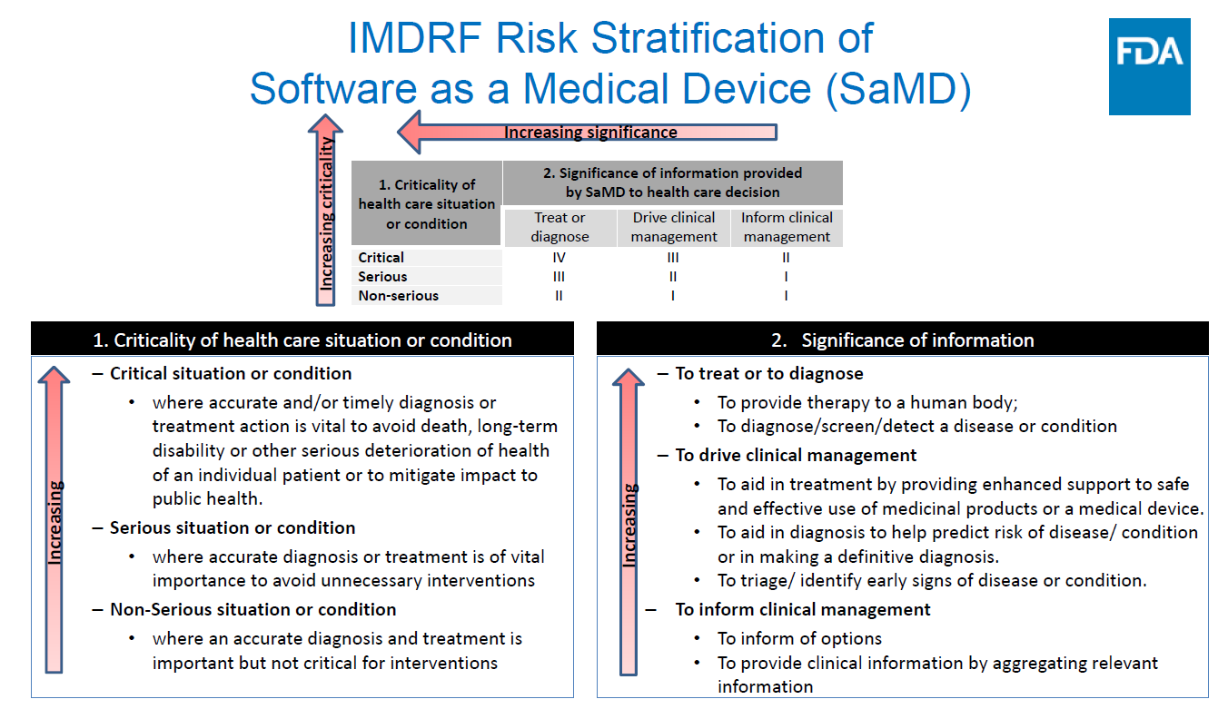
FDA Regulation of CDS (3 of 4)
FDA Webinar: Clinical Decision Support Software https://www.fda.gov/media/132202/download

Slide 71
FDA Regulation of CDS (4 of 4)
For CDS software to be exempt from meeting the definition of a device, it must meet the following criteria:
Not intended to acquire, process, or analyze a medical image or a signal from an in vitro diagnostic device or a pattern or signal from a signal acquisition system
Intended for the purpose of displaying, analyzing, or printing medical information about a patient or other medical information
Intended for the purpose of supporting or providing recommendations to a health care provider (HCP) about prevention, diagnosis, or treatment of a disease or condition. NOTE: Software functions that support or provide such recommendations to patients or caregivers remain in the definition of device
Examples include software that suggests possible diagnoses and recommends treatment plans or diagnostic tests based on patient-specific information, and when combined with other information the intended HCP would generally use, would inform the HCP’s decision regarding the prevention, diagnosis, or treatment of a patient’s disease or condition
NOTE: This guidance has not been finalized into regulation at this time

Slide 72
Anatomic Pathology & Laboratory Information Systems (AP-LIS)
Return to Navigation
Evidence Review
Existing Tools
Current Clinical Practices
Pathologists and associated specialists play a key diagnostic role in CCSM
Anatomic Pathology (AP) & Laboratory Information Systems (LIS) are their primary tools for recording and reporting test results
Required management data originates in AP-LIS and related systems:
Cytology results (pap smear)
HPV test results
Colposcopy & biopsy results
Quality Measurement
Environmental
Scan
Patient Experiences
Information Standards
EHR and Related Capabilities
Anatomic Pathology & Laboratory Information Systems

Slide 73
AP-LIS: Key Takeaways
LIS are designed to facilitate the laboratory and pathology workflow
Primary focus is NOT getting information into the EHR in a particular format
There are many types of LIS
Different vendors and different specialties (e.g., clinical pathology, anatomic pathology)
Laboratory and pathology capabilities typically supported by multiple LIS
Data capture varies lab-to-lab and vendor-to-vendor
Discrete fields (rare) vs. textual narrative (typical)
Notice: Discrete fields may be converted to plain text for transmission to EHR
Interpreting AP-LIS data in the EHR takes some effort
Manual transcription to discrete fields
Natural Language Processing (automation)
Neither are great solutions

Slide 74
AP-LIS: Overview (1 of 3)
EHRs and LIS are focused on different activities [41]
EHRs support clinical workflow, display data from multiple systems, and provide decision support
LIS are focused on laboratory operations and workflow
Main functions of LIS [42]:
Interface with lab equipment
Maintain dictionaries
Manage specimens and workflow
Facilitate report generation
LIS are fundamental to the operation of the laboratory [41]
A laboratory may be supported by more than one LIS [41]
E.g., one system for AP and another for clinical pathology [42]
Sometimes called the “engine” of the laboratory [42]

Slide 75
AP-LIS: Overview (2 of 3)
Routine Screening
Lab Testing
Communicate Results to Provider & Patient
AP-LIS workflow includes [45]:
Accession: Register a new specimen for processing
Grossing: Provide a gross description of the specimen
Specimen processing: Slide preparation
Report generation: Pathologist examines specimen and enters diagnosis and descriptive comments into LIS
More generally these fall into one of the three phases of the specimen lifecycle [59]:
Pre-Analytical: Specimen management and tracking
Analytical: Tests are performed
Post-Analytical: Report generation and dissemination, billing, etc.
Accession
Report Generation
Grossing
Specimen Processing

Slide 76
AP-LIS: Overview (3 of 3)
Dictionaries (database tables) are the ”heart” of LIS [45]
LIS are, at their core, a database for the laboratory
LIS dictionaries are used to store key definitions and configurations [45]:
Data definitions
Terminologies
Naming conventions
Report content and formats
Other laboratory configurations
LIS dictionaries describe how LIS are customized for a particular laboratory and workflow [45]

Slide 77
AP-LIS: Data Capture (1 of 4)
LIS may provide one or more of the following to facilitate data entry [45]:
Speech to text
Templates and boilerplate
Checklists
Final diagnosis data fields are typically entered and stored as text Binary Large Objects (BLOBS) [45]
Many LIS will have a structured set of fields to facilitate data entry
But the data still gets saved as one BLOB
Some LIS have modules which allow for synoptic reporting [45]
Report data recorded in discrete fields
This is beneficial since it facilitates data discovery and interpretation

Slide 78
AP-LIS: Data Capture (2 of 4)
Most pathology reports are narrative, unstructured text and require either manual review or machine information extraction [51]
ICD diagnoses codes should be, but are not always, provided with each final pathology report [46]
These ICD codes would be in addition to whatever diagnoses the clinician makes based upon the pathology report
Billing codes (e.g., CPT) may also be included in the report
Another challenge with information exchange is a lack of a consistently-used ontology like SNOMED CT [I-11]
Not all labs use these codes [I-11]

Slide 79
AP-LIS: Data Capture (3 of 4)
Available standards do not cover the full realm of reporting entities encountered in surgical pathology [46]
There are College of American Pathologists (CAP) reporting templates (discrete fields) for malignant neoplasms, but not much in the way of standards for benign lesions [46]
See the Information Standards section for more on the CAP templates
Cancer registries regularly pull data from laboratories [I-11]
CDC is working with laboratories at national & regional level to get data reported to state cancer registries [I-11]
Cancer registries are encouraging labs and pathologists to use CAP checklists
Current checklists focus on surgical staging and biomarker templates. None exist for pre-cancer or cancer screening [I-11]
CAP has started working directly with vendors so that any updates to their template would not experience a lag before being implemented into LIS [I-11]

Slide 80
AP-LIS: Data Capture (4 of 4)
Part of the lack of standards is due to the testing equipment [I-9]
Extensive variability in testing equipment that is available to different labs
A lot of laboratory data is produced directly by the equipment
Outpatient centers may order cytology and HPV tests with different criteria
Providers (ordering lab test) are not always on the same page as the pathologists (performing lab test) [I-9]
Providers control what specific lab test is ordered, although pathologists typically have insights regarding the most suitable lab procedure
Smaller labs will risk losing clientele if they cannot accommodate clinician requests
Labs are starting to offer educational materials so that clinicians are aware of their procedures and capabilities

Slide 81
AP-LIS: EHR Integration (1 of 4)
Harmonizing codes for tests has been identified as a key challenge that can be encountered when trying to integrate EHRs and LIS [48]
Both clinical and laboratory workflows will need to be adjusted to allow for tighter integration of LIS and EHRs
Although fully integrated EHR-LIS systems are not required by the CMS EHR Incentive Program, many healthcare organizations have chosen to implement them [49]
EHR-LIS interfaces that accommodate the full spectrum of the laboratory testing workflow can decrease turnaround time and improve efficiencies
Transition between different LIS requires a lot of forethought and planning [54]
Unforeseen consequences can still occur
This is true even if using an LIS product from the same vendor as your EHR

Slide 82
AP-LIS: EHR Integration (2 of 4)
LIS vendors should work with EHR vendors and pathologists should work with clinicians to ensure the right information makes its way to the decision-making process [41]
Some EHR vendors are developing their own LIS that easily integrate with their EHR and other products
e.g., Epic Beaker and Cerner CoPath
A recent survey highlighted multiple areas where Epic Beaker could be improved [44]
Ideal LIS need to take into account interfaces and interactions with the EHR(s) [55]
LIS integration with EHR systems is critical as another layer of communication with the patient [I-12]
Integration enhances communication so that care providers can see every time a patient has an encounter with the integrated health system
Helps avoid excessive screening and could put the patient, the clinician, and the rest of the care team on the same page

Slide 83
AP-LIS: EHR Integration (3 of 4)
Historically, lab tests informing the same screenings would be bundled into the same report, which would be sent back to provider who ordered the test [I-9]
Since the 21st Century Cures Act, more LIS have been releasing results in real-time directly to the patient, bypassing precursory provider review
This can be burdensome as patients will sometimes call the pathology lab with questions instead of interacting directly with their provider
Bethesda System is widely used standard for cytology; however, HPV test results are almost always relayed as free-text (see Information Standards) [I-11]
Some labs have been working with state registries to further standardize screening data

Slide 84
AP-LIS: EHR Integration (4 of 4)
Pathologists like to write in-depth notes [I-11]
Providers will not always read everything; therefore, they may miss critical information in long pathology reports
In lieu of widespread standards or manual review by providers, automated information extraction of pathology reports promises to help bridge gap between AP-LIS and EHRs
Enabling technology is called Natural Language Processing (NLP)
See the Existing Tools section for more information on NLP approaches taken with CCSM

Slide 85
Information Standards
Return to Navigation
Evidence Review
How information is formatted in the EHR is important because it impacts the ability to implement effective CDS
Lack of information standards when it comes to CCSM means test results have to be either transcribed manually or automatically extracted by a machine
Having more robust data standards is the preferrable solution
Existing Tools
Current Clinical Practices
Quality Measurement
Environmental
Scan
Patient Experiences
Information Standards
EHR and Related Capabilities
Anatomic Pathology & Laboratory Information Systems

Slide 86
Information Standards: Key Takeaways
The US Core Implementation Guide defines how pathology reports must be made available in certified EHRs in the future
Currently data tends to be primarily reported by AP-LIS via free-text reports
Logical Observation Identifiers Names and Codes (LOINC) lab identifiers lack proper integration within AP-LIS due to complexity and lack of incentives
Systematized Nomenclature of Medicine Clinical Terms (SNOMED-CT) result codes are not actually mandated and infrequently used
No widely-used structured format available for all data needed to support CCSM
The Bethesda System defines a lexicon for reporting cervical cytology results, but its result categories tend to still be embedded within free-text reports
College of American Pathologists (CAP) electronic Cancer Checklists (eCCs) define how to capture cancer pathology in a structured format, but limited by proprietary restrictions and lack of adequate support and mapping for CCSM data

Slide 87
Information Standards: US Core Data Standard (1 of 2)
The 21st Century Cures Act was passed in 2016 to accelerate medical innovation in a more efficient manner [60]
To increase health data interoperability and to mitigate information blocking, the Cures Act (section 4002) mandated the establishment of requirements for the Office of the National Coordinator for Health Information Technology (ONC) Health IT Certification Program [60]
The ONC Cures Act Final Rule requires that all certified health IT systems must represent a core subset of health information in FHIR, a data standard for exchanging healthcare information electronically [60]
The U.S. Core Data for Interoperability (USCDI) was created as a minimum set of data classes that are required to be interoperable nationwide [61]

Slide 88
Information Standards: US Core Data Standard (2 of 2)
The US Core Implementation Guide defines how the FHIR data standard is to be used to exchange the health information included in the USCDI [62]
It defines what health data should look like by placing restrictions on FHIR Resources, the core building block of the FHIR EHR standard
The US Core Diagnostic Report Profile for Report and Note exchange defines how pathology reports are to appear in FHIR [62]
This Diagnostic Report profile defines a LOINC code that is to be used if the report is of the category “Pathology”

Slide 89
Information Standards: Commentary
While a US Core Diagnostic Report provides guidance for how pathology data should appear in an EHR, the results of the pathology report can be conveyed in different ways
Preferably, pathology reports would map to discretely coded results that could be queried by a health application (like CDS)
However, in practice, pathology results tend to come back from the lab as free-text narratives, which would then be appended as an attachment to the Diagnostic Report in FHIR
This narrative reporting scheme makes it laborious to extract relevant clinical information from a patient’s EHR
Requires clinical interpretation or NLP to extract discrete results
US Core will make the data available but not necessarily easily interpretable

Slide 90
Information Standards: Synoptic Reporting (1 of 2)
Synoptic reporting is a process for reporting specific data elements in a specific format in surgical pathology reports [53]
Previously, surgical pathology reports were all free-text, highly narrative, and prone to omission of necessary data and inconsistencies in formatting [53]
Synoptic reporting not only ensures that all reports contain all necessary data elements, but also is amenable to scalable data capture, interoperability, and exchange [53]
CAP is encouraging, where data is captured as questions with corresponding answers [I-5]

Slide 91
Information Standards: Synoptic Reporting (2 of 2)
CAP created eCCs that map pathological input to discrete values using synoptic reporting [63]
eCCs enable pathologists to use CAP’s synoptic reporting cancer protocols directly within their LIS workflow and ensure that each report is completed with the necessary required elements [63]
CAP eCCs integrate the Structured Data Capture (SDC) standard developed by Integrating the Healthcare Enterprise (IHE) International [64]
SDC defines how clinical information can be captured and mapped to discrete data elements using sets of questions and answers [64]
The IHE SDC workgroup has developed a way to map these structured sets of questions and answers to the FHIR US Core Implementation guide [65]
Can translate IHE SDC to FHIR Observations, which can be referenced from within a FHIR Diagnostic Report for pathology or transmitted via a FHIR message bundle [I-5].
However, this mapping has not yet been implemented for all types of pathology reports

Slide 92
Information Standards: CAP eCC (1 of 2)
eCCs have been fairly widely implemented across North America [I-5]
Over a third of all pathologists use eCCs
Some provinces in Canada mandate use and use is almost 100%
eCCs are an XML format defined by CAP [51]
Question and answer forms
"Ckey" identifiers used for each item
These can be mapped to SNOMED, a coding standard strongly supported by US Core
Checklists like eCCs are associated with higher completion rates for pathology reports [53]
Over 5000 pathologists were using eCCs as of September 2018 [51]
CDC has worked with CAP to develop cancer protocols and eCCs for standardized reporting of coded cancer pathology and biomarker data [47]

Slide 93
Information Standards: CAP eCC (2 of 2)
Old workflow was text entry into a report and the encoding happened afterwards / separately [51]
New workflow involves filling out the eCC and then a human readable report is generated along with the encoded discrete information [51]
SDC facilitates the implementation of eCCs [51]
SDC allows for more sophisticated data entry systems
Nebraska Lexicon working on mapping CAP synoptic reporting to SNOMED CT and LOINC [51]
US Core supports using LOINC and SNOMED codes as respective questions and answers within a pathology report
The Nebraska Lexicon mapping is currently limited to breast and colon cancers [39]
SDC still a work in progress [51]
Towards expanding breadth of synoptic reporting data coverage and increasing exposure across current LIS

Slide 94
Information Standards: Checklist Improvements
There have been efforts to streamline the CAP checklists [50]
Making them easier to use may increase accuracy and compliance [50]
Interactive web-based implementations of the CAP checklists have been proposed and piloted [50]
Have shown improved accuracy and lower amendment rates [50]
Additional benefits come from removing optional data elements, automated reminders for missing elements, and forcing functions [53]
Old guidance for how pathology reports should be formatted could still have some bearing for narrative portion of eCC and SDC approaches [56]

Slide 95
Information Standards: Checklist Licensing
CAP checklists and American Joint Commission on Cancer (AJCC) TNM staging system are both copyrighted [53]
CAP eCC schema is free, but the actual forms are licensed when filled in [I-5]
Recent adoption of eCCs, which require a license, has been slow because there are no incentives for labs to change their workflows [47]
These restrictions may inhibit adoption [53]

Slide 96
Information Standards: Current Practices (1 of 2)
Pathology Results Capture and Interpretation [I-9] [I-11]
Cytology (Pap) Tests
Bethesda System is widely used standard for PAP test [I-9]
It is a uniform reporting system [43] created in 1988 to standardize data and improve communication of cytology results
Defines concrete “categories” of cytology results [40]
Although Bethesda System defines discrete fields, many labs will report these results using unstructured, free-text [I-11]
HPV Tests
HPV Tests results are almost always relayed as free-text [I-9]
Recent push towards being more specific with HPV test reporting [I-11]
Shift from simply reporting +/- to reporting more specific viral strand (ex. HPV-16 vs. HPV-18)

Slide 97
Information Standards: Current Practices (2 of 2)
Pathology Results Capture & Interpretation [I-12]
High degree of regional variability in how pathologists work
Labs are highly resistive to introducing standardization for reporting results or providing discrete results in conjunction with narrative report
They have little incentive to do so

Slide 98
Information Standards: Other Standards (1 of 3)
CAP Cytopathology Accreditation Checklist [40]
Guidelines for how to write a cytopathology report and what information to include
However, does not specify a format other than PDF (non-discrete data)
LOINC’s complexity makes it difficult to be properly adopted by labs [52]
It is resource-intensive to select the most correct code for each lab test
Codes are not uniformly assigned across laboratories
2 inequivalent tests may be assigned the same LOINC code
Laboratories are not directly incentivized to adopt standards like LOINC [52]
They do not qualify for the same quality measure incentives as hospitals do
However, many laboratories include LOINC codes in their data so that their customers (e.g., hospitals) can meet their own reporting requirements [52]

Slide 99
Information Standards: Other Standards (2 of 3)
Needs and requirements around cancer reporting and cancer registries are driving interoperability in LIS [47]
Many Central Cancer Registries (CCRs) are receiving reporting data in HL7 Clinical Document Architecture (CDA) [47]
While CDA requires some high-level structured metadata fields, the document’s body can be a PDF, a Microsoft Word document, or even a scanned image file [68]
Increasing availability of cancer reporting data available via FHIR APIs is active area of work [47]

Slide 100
Information Standards: Other Standards (3 of 3)
minimal Common Oncology Data Elements (mCODE) is a MITRE-led initiative to create a core cancer model and foundational EHR data elements [67]
The mCODE implementation guide builds on U.S. Core to define the minimal data elements needed to accurately convey important information about a patient’s cancer condition and their care
mCODE’s early work focused on breast cancer; the initiative is now in the process of identifying extensions that could be applied for other use cases
Is currently focused on treatments and disease outcomes
Assumes things that inform staging (pathology reports) are already in the EHR
Does not specify data elements within pathology reports

Slide 101
Quality Measurement
Return to Navigation
Evidence Review
Quality measurement describes an observed level of activity.
Quality measures are used by payers, federal and state agencies, and accreditation bodies to assess the quality of healthcare.
Existing Tools
Current Clinical Practices
Quality Measurement
Environmental
Scan
Patient Experiences
Information Standards
EHR and Related Capabilities
Anatomic Pathology & Laboratory Information Systems

Slide 102
Quality Measurement: Key Takeaways
Challenges include unintended consequences and availability of data, particularly when patients are seen by multiple providers.
Federal, national, and state programs include cervical cancer screening measures in their quality reporting activities.
Cervical cancer screening measures currently exist to evaluate routine screening in adults and overscreening in adolescents.
Data standards used for quality measurement are in state of transition to align with standards used for clinical decision support.
Consensus-building forums exist to propose and gain support for novel quality measurement areas.
An intensive measure development process exists and is outlined in the CMS Measures Management System Blueprint.

Slide 103
Quality Measurement: Quality Reporting Programs
Programs that include cervical cancer screening quality measures:
CMS Medicare Quality Payment Program (QPP) Merit-based Incentive Payment System (MIPS) - Eligible clinicians report measures through the Electronic Clinical Quality Measures (eCQM) collection type or MIPS Clinical Quality Measures (CQM) collection type
Healthcare Effectiveness Data and Information Set (HEDIS) - Health plans and other health care organizations submit HEDIS data to the National Committee for Quality Assurance (NCQA)
Health Resources and Services Administration (HRSA) Health Center Program Uniform Data System (UDS) Reporting – Health centers submit UDS reports annually to HRSA’s Bureau of Primary Health Care
Center for Medicaid and CHIP Services (CMCS) – CMCS partners with stakeholders to identify Child and Adult Core Sets of health care quality measures

Slide 104
Quality Measurement: Cervical Cancer Screening eCQM
CMS124/Quality ID 309 Cervical Cancer Screening (NCQA is measure steward)
Description - Percentage of women 21-64 years of age who were screened for cervical cancer using either of the following criteria:
Women age 21-64 who had cervical cytology performed every 3 years
Women age 30-64 who had cervical cytology and human papillomavirus (HPV) co-testing performed every 5 years
Programs using this measure include:
HRSA Health Center UDS Reporting
CMS Medicare QPP MIPS
EHR reporting is one of six collection methods for quality reporting
Clinicians report on six measures or specialty set
CC Screening included in specialty set for Family Medicine, Internal Medicine, Ob/Gyn
NCQA HEDIS Reporting - Applies to Commercial, Medicare, and Medicaid Payers
CMCS Medicaid Adult Core Set

Slide 105
Quality Measurement: Cervical Cancer Screening CQM
Quality ID 443 Non-Recommended Cervical Cancer Screening in Adolescent Females
Description - The percentage of adolescent females 16-20 years of age who were screened unnecessarily for cervical cancer
Programs using this measure include:
NCQA HEDIS Quality Reporting – Applies to Commercial and Medicaid Payers
CMS Medicare QPP MIPS CQM collection method

Slide 106
CDC National Breast and Cervical Cancer Early Detection Program (NBCCEDP) [77]
Grantees (e.g., health centers, health care/hospital networks, Indian Health Service) are required to report baseline and annual data to CDC for every participating clinic
Acceptable Cervical Cancer Screening Rate Measures
Government Performance and Reporting Act (GPRA) used by the Indian Health Service
Health Care Effectiveness Data and Information Set (HEDIS)
Health Resources & Services Administration (HRSA) Uniform Data System (UDS)
National Quality Forum (NQF) Endorsed Measure

Slide 107
Quality Measurement: Management of Abnormal Screening Results (1 of 2)
Quality measures do not currently exist to measure performance of adequate management of abnormal screening results
Could consider a measurement of appropriate rates of referral or follow-up [I-16]
Would be challenging due to providers delivering different levels of care – e.g., primary care providers in rural areas may perform procedures that peers in urban settings would not.
The small proportion of abnormal screening encountered equates to a small numerator for such a measure. “A small practice may have only 1 or 2 positives a year.”

Slide 108
Quality Measurement: Management of Abnormal Screening Results (2 of 2)
May introduce clinician burden associated with collecting the clinical data required for measurement
Would be easier if clinical data were more commonly shared across settings.
May not be fair to hold clinicians accountable until system interoperability is better [I-16]
Managing abnormal results may involve tracking tests and procedures performed in multiple settings (e.g., primary care provider, OB/GYN specialist, colposcopist, outpatient surgery) making it more challenging to collect clinical data
In assessing abnormal results, it may be difficult to distinguish between surveillance, biopsy, or referred on treatment leading to difficulty in identifying a single measure of quality [I-20]

Slide 109
Quality Measurement: Existing Preventive Care and Screening eCQMs (1 of 2)
Existing CMS eCQMs based on USPSTF recommendations and include a follow-up component:
CMS2v10 Preventive Care and Screening: Screening for Depression and Follow-Up Plan
CMS22v9 Preventive Care and Screening: Screening for High Blood Pressure and Follow-Up Documented
CMS69v9 Preventive Care and Screening: Body Mass Index (BMI) Screening and Follow-Up Plan
CMS138v9 Preventive Care and Screening: Tobacco Use: Screening and Cessation Intervention
CMS50v8 Closing the Referral Loop: Receipt of Specialist Report

Slide 110
Quality Measurement: Existing Preventive Care and Screening eCQMs (2 of 2)
Existing CMS eCQMs assessing preventive care and screening based on USPSTF recommendations are not as complex as what would be required for management of abnormal results.
The data points used to determine follow-up are generally discrete (i.e., blood pressure, depression screening score, BMI, and tobacco use) and available to the clinician during the screening encounter.
For cervical cancer screening, the screening test can take days to weeks before the ordering provider sees the results [I-10]
The cervical cancer screening results may be returned in separate reports (e.g., in the case of co-testing where the Pap is processed by one lab and the HPV processed by another lab) [I-10]

Slide 111
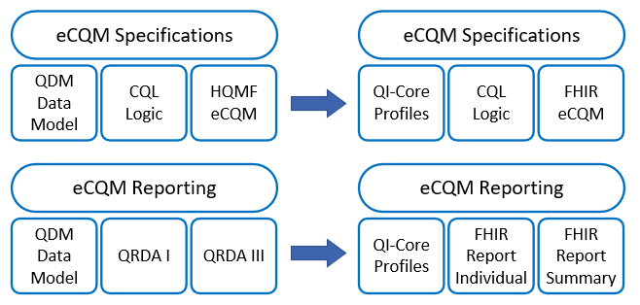
Quality Measurement: Existing eCQM Standards
Currently eCQMs and CDS use different data standards
The quality measurement community is converting and testing measures using the FHIR standard
Goal is to align quality measurement standards for eCQM development and reporting using FHIR
Current standards
Proposed standards

Slide 112
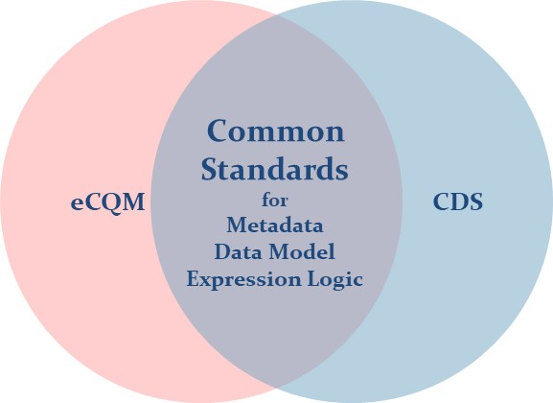
Quality Measurement: Alignment of eCQM and CDS Standards
Common Standards can reduce burden by:
Creating artifacts and logic pieces that can be shared between eCQMs and CDS
Eliminating the need to learn and maintain multiple standards
Aligning clinical systems with data needed for quality measurement
Streamlining exchange of data by using a common interoperability framework
Accelerating the adoption of measures by reducing the effort to map to clinical systems

Slide 113
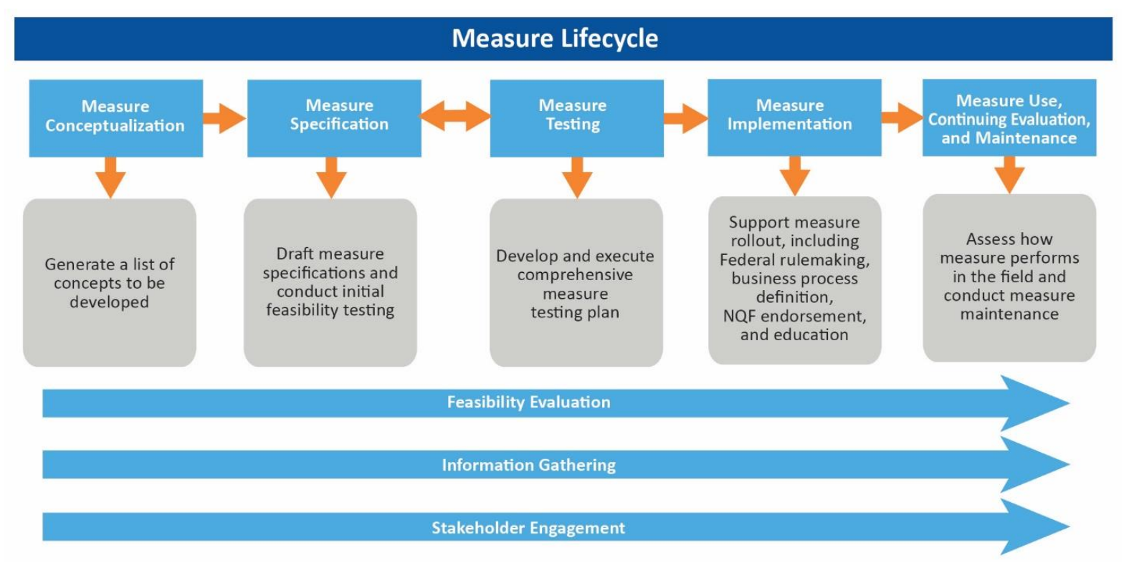
Quality Measurement: CMS Measure Lifecycle [75]

Slide 114
Quality Measurement: Challenges
The measure development lifecycle is a multi-year, rigorous process that involves feasibility evaluation, information gathering, and stakeholder engagement.[75]
Measure development principles include focusing on addressing performance gaps where there is known variation in performance – e.g., activities that clinicians can do such as ordering a referral or follow-up test.[75]
Although performance measures may effectively improve underscreening, they often do little to decrease overscreening and may even encourage overscreening among providers who are concerned about when their patient may return to their clinic. [30]
New guidelines promote less frequent screening. Some insurance companies have not yet adopted new guidelines and will still reimburse for overscreening. [I-11]
Disincentivizes clinicians from following new guidelines
Consider a measure that assesses overscreening

Slide 115
Quality Measurement: Collaboration Opportunities
NCQA Digital Measurement Community
Serves as collaborative portal for people who develop, use and support digital quality measures.
National Quality Forum (NQF) Measure Applications Partnership (MAP) Clinician Workgroup
Provides input to NQF’s Coordinating Committee on matters related to the selection and coordination of measures for clinicians, particularly in the office setting.
Core Quality Measures Collaborative
Public-private partnership between America’s Health Insurance Plans (AHIP) and the Centers for Medicare & Medicaid Services (CMS) housed at the National Quality Forum (NQF).
Facilitates cross-payer measure alignment through the development of core sets of measures to assess the quality of healthcare in the United States.
National Health Quality Roadmap
Created to improve patient outcomes through enhanced effectiveness and efficiency of the healthcare quality system supported by federal investments

Slide 116
Existing Tools
Return to Navigation
Evidence Review
Complexity of guidelines drives need for CDS
There are many examples of existing CDS tools across health systems and major vendors
Existing tools specific to cervical cancer screening (Mayo Clinic CDS) provide lessons to learn from
NLP is a core component of many existing CDS tools, but it brings unique challenges
Existing Tools
Current Clinical Practices
Quality Measurement
Environmental
Scan
Patient Experiences
Information Standards
EHR and Related Capabilities
Anatomic Pathology & Laboratory Information Systems

Slide 117
Existing Tools: Key Takeaways
Most consistent feedback from providers is that complexity of information is increasing and CDS support is needed to access it faster, more efficiently, and in a more targeted manner [I-4]
CDS is not replacing the provider’s authority, but rather provides and classifies relevant information that allows the specialist to make better and more informed decisions
CDS tools can be deployed in several ways for patients’ care, from virus detection to personalized cancer therapies
A few existing CDS tools attempt to inform clinical decisions based upon EHR data
HealthPartners Institute – Develops CDS integrated with EHR
Cerner EHR - HealthDecision Suite of CDS Tools
Mayo Clinic CDS for Cervical Cancer with NLP
NLP solutions for Pathology-Clinical Workflow
Preferred modern NLP strategies are partially automated so they inform clinicians without bypassing their discretion [I-12]
Yale University School of Medicine group had success developing an NLP algorithm for surveillance of cervical cancer and precancer

Slide 118
Existing Tools: Need for CDS
Clinical Decision Support provides clinicians, staff, and patients with knowledge and person-specific information, intelligently filtered or presented at appropriate times, to enhance health and health care
Clinical decision support tools can help oncologists manage complexity: [1]
Digital solutions like CDS can aid providers in managing guideline complexity. Based on algorithms and computing power, CDS tools can structure and filter clinical data to help providers make more informed treatment decisions faster
Recent study with 130 oncologists from U.S. and Europe, only one-fifth are routinely using CDS tools today
CDS solutions are quickly becoming an ever-more efficient analytical tool for the healthcare industry: [11]
Machine learning and artificial intelligence techniques enable these systems to store and analyze a massive volume of data to identify hidden patterns and deliver precise results for healthcare practitioners and patients
The complexity of the EHR workflow is reportedly taking its toll on providers, who are now spending more time finding and analyzing the patients’ information vs time spent with patients

Slide 119
Existing Tools: Approach [1]
CDS tools implemented without regard to organizational context or patient context can add complexity rather than reducing it:
CDS that is too general can ask too many questions of providers and can require providers to filter information themselves
CDS should make decisions in the background, mitigating the role the physician must play in triggering the right information
Complaint heard from providers is that “too much useless data is thrown at them”
CDS tools need to be good at understanding the context in which the provider is making a decision
When it comes to deciding on the right treatment, CDS is not replacing the physician’s authority but rather provides and classifies relevant information that allows the specialist to make an even better and more informed decision
Improved algorithms and more real-world data can help CDS evolve to become more accurate in the future

Slide 120
Existing Tools: Examples of CDS Tools in Use (1 of 3)
CDS tools can be deployed in several ways for patient care from virus detection to personalized cancer therapies. Examples of CDS in use today: [11]
A hospital in Alabama used a computerized surveillance algorithm to reduce sepsis mortality rate by 50%
Mayo Clinic is implementing a CDS for nurses to support the patient phone screen process
Unity Health Medical Center implemented a CDS using genetic testing data to reduce ED visits and readmissions
Yale and Mayo Clinic developed a specialized CDS for patients with head injuries
AllScripts Infera CDS application covers conditions seen mostly by primary care providers, including preventive care. It reads structured and unstructured patient data from the EHR, then analyzes the unique details of the patient’s condition against its evidence-based clinical rules, delivering specific care recommendations in real time. Infera is integrated with Allscripts Professional and Touchworks EHRs and is certified by the Allscripts Developers Program [14]
EHRs like Mercy's Epic system are applying CDS tools to their large collection of patient information. CDS Initiatives include CDS for radiology imaging, CDS for identifying gaps in patient care, CDS for heart failure patients [21]

Slide 121
Existing Tools: Examples of CDS Tools in Use (2 of 3)
HealthPartners Institute has pioneered development and implementation of CDS that is integrated with the EHR [12]
Clinical algorithms identify health risks and multiple medical conditions and give treatment suggestions and reminders for patients and clinicians to consider. Algorithms are maintained so they remain updated as new evidence emerges, and guidelines change.
Current projects: medication adherence, identification and management of chronic kidney disease, diagnosis and treatment of opioid use disorder, diabetes care, reduce risk of cardiovascular disease, cancer screening and prevention (breast, colon, lung, cervical cancer screening) in a rural health system

Slide 122
Existing Tools: Examples of CDS Tools in Use (3 of 3)
The Cerner HealthDecision suite of CDS tools displays personalized guidelines and dynamically illustrates risk to support shared decision-making conversations at the point of care, all within the Cerner Millennium EHR workflow. It is integrated into the EHR using SMART and FHIR interoperability standards [4]
HealtheIntent – Cerner cloud-based big data platform receives clinical and administrative data from a variety of EHRs and data sources. Includes a registries type product to support population health [I-7]
Cerner Millenium is a local EHR that is not dependent on having HealtheIntent. Has a health maintenance module for preventive type services [I-7]
Cerner Care Pathways platform is a new feature to accommodate CCSM; used to build out algorithms for local guidelines [I-7]
Currently, Cerner has no functionality supporting cervical cancer management [I-7]

Slide 123
Existing Tools: Mayo Clinic (1 of 4)
Mayo Clinic’s initial cervical cancer CDS effort from 2012 [31] (open-source code available on GitHub)
Developed cervical cancer screening that includes a free-text rule base for interpreting Pap reports using NLP and a guideline rule base [31]
Two possible approaches are either a data-driven artificial intelligence NLP system, or an expert knowledge-based approach [I-1]
They used an expert system, implementing if and else statements to defined rules based upon clinical expertise
Used a data dictionary to map free-text cytology reports [I-1]
Restricted free-text rule base to rules that were required to decide four parameter values. The evaluation of these four parameters involved recognition of the 11 concepts in the pap report [31]
This work was put on pause with Mayo Clinic’s transition to Epic health IT system [I-1]

Slide 124
Existing Tools: Mayo Clinic (2 of 4)
Lessons Learned from Mayo Clinic’s 2012 cervical cancer CDS work:
HPV testing is sometimes performed separately from the pap test and reported in a different lab system. These results were initially missed [31]
A SME physician provided guidance on the CDS rule base (including how to interpret pathology reports) and evaluated the CDS recommendations [31]
Pathology reports populated in a template aided in reasoning over the results [31]
CDS provided decision explanations to the physicians, along with links to the evidence [31], [32]
Patient-reported responses (e.g., Have your menstrual periods changed in anyway or become abnormal to you?) were used to obtain some data required by the CDS [31]
Utilize more than 1 SME when building out rules. Inclusion of peer review and diverse perspectives can mitigate errors. In addition, have SMEs proof check the CDS recommendations [33]
History of hysterectomy can be missed due to lack of discrete documentation on problem list or patient-provided information [33]. Consider gathering this information from a patient survey or using NLP to evaluate clinical notes
Doing a formative evaluation of the CDS prior to deployment is important. An error analysis was used to improve Mayo’s CDS [33]
Critical to generate trust in the system [I-1]

Slide 125
Existing Tools: Mayo Clinic (3 of 4)
Lessons Learned from 2014 efforts:
To ensure accuracy of data extraction, reconciliation is performed across multiple sources (e.g., history of hysterectomy is searched for in surgical reports, problem lists, clinical notes, survey responses) to inform if the patient should have cervical, vaginal or no cytology testing, etc. [32]
NLP and data reconciliation techniques have a critical role in data extraction (4 of the 10 required data elements for the CDS were obtained via these approaches) [32]
Consider multi-pronged approach: combining patient reminders (via email or letter) with presenting a list of high-risk patients for clinician review [20]
Cytology and pathology reports are not standardized [I-1]
Change in data sources can create issues [I-1]
It is important to consider how to handle missing data – you can have logic stop, or implement a way to bypass decision point and continue forward [I-1]
Physicians appreciate time savings of seeing both the recommendation and the supporting detail of why the recommendation was made. [I-1]
A preferred enhancement might be some kind of "push" to the clinician and even to the patient [I-1]
Nice feature: "i" information icon to hover over which explains what to do next (test type, interval) [I-1]
Ideal to have CDS recommendation on the actual biopsy report results [I-1]

Slide 126
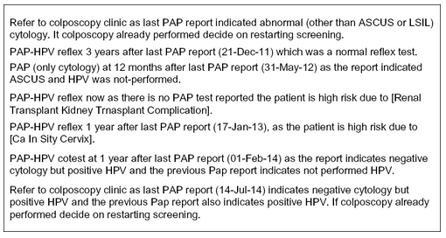
Existing Tools: Mayo Clinic (4 of 4)
Sample Explanations Generated by the CDS
Wagholikar KB, Maclaughlin KL, Casey PM, et al. Automated Recommendation for Cervical Cancer Screening and Surveillance. Cancer Informatics. January 2014. doi:10.4137/CIN.S14035

Slide 127
Existing Tools: Natural Language Processing (1 of 4)
Role of NLP in Pathology-Clinical Workflow [I-12]
New ASCCP app: It doesn't take much to hit point where app defers to clinician judgement:
Clinician must manually review and interpret patient data and enter it into ASCCP app
Demonstrates need for NLP to extract data elements that may be buried within free-text pathology reports
According to a Yale clinical NLP group, preferred modern NLP strategies are partially automated, so that they can inform clinicians without bypassing their discretion altogether (see next slide)
Automation allows computer to learn as you go and avoids laborious process of constantly updating lexical dictionary
Ideal integration point would be in pathology lab, after results are generated
Ideal output would involve a discrete result alongside a narrative report to be referenced as context for clinical decision

Slide 128
Existing Tools: Natural Language Processing (2 of 4)
Rule-Based vs. Statistical [I-12]
Rule-Based NLP
Hybrid Approach
Statistical NLP
Use deep learning techniques
Easier to build: less hard-coding
Easier to implement: no need to constantly update lexical dictionaries
Becoming more prevalent with advancement of machine learning technology
Lexical dictionaries define keywords to be extracted
Context dictionaries to interpret presence or negation of data element
Easier to see why certain clinical decision is made
Become stale as guidelines and pathology methods evolve
Mixed dictionary and machine learning approach for different steps of pipeline
Statistical results come back with an associated probability

Slide 129
Existing Tools: Natural Language Processing (3 of 4)
Current Medical Applications of NLP
Mayo Clinic Cervical Cancer CDS [24]: Mayo integrated NLP into their 2018 cervical cancer CDS system
Uses large dictionary built with Java Drools to map key words from unstructured pathology reports
MedTagger [23, 34, 35]: An actively maintained, open-source framework developed by Mayo Clinic for indexing, information extraction, and machine learning
Uses dictionaries to extract relevant information about specific diseases
Apache cTAKES [10, I-6]: A widely used NLP system for extraction of information from clinical free-text reports within an EHR
Used to find named entities from progress notes and clinical notes
A full-system rule-based NLP pipeline developed by Mayo Clinic, using their MedTagger tool for information extraction.
CLAMP [58, I-6]: A UT Health NLP tool available free for non-profit use

Slide 130
Existing Tools: Natural Language Processing (4 of 4)
Yale University School of Medicine group developed an NLP algorithm for surveillance of cervical cancer and precancer [I-12, 58]
NLP Pipeline:
Initially used Apache cTAKES
Easily implemented as it was already integrated into Health IT system
Difficult to modify pipeline for different uses
Switched to CLAMP
Contains pretrained algorithms that can compute relatively quickly at runtime
Outcomes:
Computation Time: able to process 10,000 pap tests in a few minutes
Easy to process results, difficult and time-consuming to load results back to EHR

Slide 131
Existing Tools: Challenges
CDS and NLP dictionaries need to accommodate data elements that may change over time [I-3]
Unstructured pathology report data will likely cause a breakdown of the CDS. Need to think about how to handle missing data [I-3]
Use of NLP will be a challenge if receiving data from different sources [I-3, 1-12]
We want to avoid another standalone app. Fully integrating CDS into an EHR that may be formatted differently within different health IT systems will be difficult [I-3]

Slide 132
Next Steps
Define CDS
(Year 1)
Pilot CDS
(Year 2)
Adoption
(Year 3)
Discuss findings with CDC team
Determine optimal pilot site and EHR characteristics
Quantify CDS effectiveness
Quality Measures
(Years 2 & 3)
Develop companion eCQM(s)
Begin CDS development
Identify potential pilot partner(s)
Brainstorm potential CDS approaches
Assess feasibility and impact of CDS options
Integrate CDS with EHR
Encourage adoption of CDS and eCQMs

Slide 133
References

Slide 134
References (1 of 9)
[1] Future of Oncology 2020 | Helping oncologists manage complexity. https://deep-dive.pharmaphorum.com/magazine/future-of-oncology-2020/clinical-decision-support-tools-will-help-oncologists-manage-complexity/ (accessed Nov. 07, 2020). Available:
https://deep-dive.pharmaphorum.com/magazine/future-of-oncology-2020/clinical-decision-support-tools-will-help-oncologists-manage-complexity/
PDF: https://www.accenture.com/_acnmedia/PDF-125/Accenture-Life-Sciences-Precision-Oncology-Digital.pdf#zoom=50
[2] Borfitz D. Digital Era Creates Communication Glitches For Pathologists. Diagnostics World [Internet]. 2019; Available from: https://www.diagnosticsworldnews.com/news/2019/09/17/digital-era-creates-communication-glitches-for-pathologists
[3] Bowen ME, Bhat D, Fish J, Moran B, Howell-Stampley T, Kirk L, et al. Improving Performance on Preventive Health Quality Measures Using Clinical Decision Support to Capture Care Done Elsewhere and Patient Exceptions. Am J Med Qual. 2018 May 1;33(3):237–45.
[4] HealthDecision [Internet]. [cited 2020 Oct 22]. Available from: https://code.cerner.com/apps/healthdecision
[5] Chaudry R. NLP-enabled decision support for cervical cancer screening and surveillance [Internet]. Agency for Healthcare Research and Quality. [cited 2020 Oct 16]. Available from: https://digital.ahrq.gov/sites/default/files/docs/citation/r21hs022911-chaudhry-final-report-2017.pdf
[6] Core Quality Measures Collaborative. Consensus Core Set: ACO and PCMH / Primary Care Measures Version 1.0. 2020.
[7] Dupuis EA, White HF, Newman D, Sobieraj JE, Gokhale M, Freund KM. Tracking abnormal cervical cancer screening: Evaluation of an EMR-based intervention. J Gen Intern Med. 2010;25(6):575–80.
[8] Evans B, Ossorio P. The Challenge of Regulating Clinical Decision Support Software After 21 st Century Cures. Am J Law Med [Internet]. 2018 [cited 2019 Jun 25];44:237–51. Available from: https://perma.cc/XMN3-VPX6]
[9] Everett T, Bryant A, Griffin MF, Martin-Hirsch PPL, Forbes CA, Jepson RG. Interventions targeted at women to encourage the uptake of cervical screening. Cochrane Database Syst Rev. 2011;2011(5).

Slide 135
References (2 of 9)
[10] Ferraro JP, Ye Y, Gesteland PH, Haug PJ, Tsui FR, Cooper GF, et al. The effects of natural language processing on cross-institutional portability of influenza case detection for disease surveillance. Appl Clin Inform [Internet]. 2017 May 31 [cited 2020 Oct 20];8(2):560–80. Available from: /pmc/articles/PMC6241736/?report=abstract
[11] Clinical Decision Support System - Benefits, Examples, Tools [Internet]. [cited 2020 Nov 7]. Available from: https://digitalhealth.folio3.com/clinical-decision-support-system-examples-tools/
[12] Clinical Decision Support - Clinical Decision analysis - HealthPartners Institute [Internet]. [cited 2020 Nov 7]. Available from: https://www.healthpartners.com/institute/research/research-strengths/clinical-decision-support/
[13] Hills RL, Kulbok PA, Clark M. Evaluating a Quality Improvement Program for Cervical Cancer Screening at an Urban Safety Net Clinic. Health Promot Pract. 2015 Sep 18;16(5):631–41.
[14] Allscripts Clinical Decision Support Application - Infera CDSS [Internet]. [cited 2020 Nov 7]. Available from: http://www.inferscience.com/what-you-need-to-know-about-infera-cdss-for-allscripts-ehrs/
[15] Javitt GH. Regulatory Landscape for Clinical Decision Support Technology. Anesthesiology [Internet]. 2018 Feb 1 [cited 2018 Dec 31];128(2):247–9. Available from: http://insights.ovid.com/crossref?an=00000542-201802000-00010
[16] Krist AH. Electronic Health Record Innovations for Healthier Patients and Happier Doctors. J Am Board Fam Med [Internet]. 2015 [cited 2019 Jan 14];28(3):299–302. Available from: http://www.jabfm.org
[17] Krist AH, Woolf SH, Hochheimer C, Sabo RT, Kashiri P, Jones RM, Lafata JE, Etz RS, Tu S. Harnessing Information Technology to Inform Patients Facing Routine Decisions: Cancer Screening as a Test Case. Ann Fam Med [Internet]. 2017;15(3):217–24. Available from: http://ovidsp.ovid.com/ovidweb.cgi?T=JS&PAGE=reference&D=emexb&NEWS=N&AN=620351528
[18] Liu H, Bielinski SJ, Sohn S, Murphy S, Wagholikar KB, Jonnalagadda SR, et al. An information extraction framework for cohort identification using electronic health records. AMIA Jt Summits Transl Sci proceedings AMIA Jt Summits Transl Sci [Internet]. 2013 Mar 18 [cited 2020 Oct 19];2013:149–53. Available from: https://europepmc.org/article/med/24303255

Slide 136
References (3 of 9)
[19] Liu H, Wu ST, Li D, Jonnalagadda S, Sohn S, Wagholikar K, et al. Towards a semantic lexicon for clinical natural language processing. AMIA Annu Symp Proc [Internet].[cited 2020 Oct 20];2012:568–76. Available from: /pmc/articles/PMC3540492/?report=abstract
[20] MacLaughlin KL, Kessler ME, Komandur Elayavilli R, Hickey BC, Scheitel MR, Wagholikar KB, et al. Impact of Patient Reminders on Papanicolaou Test Completion for High-Risk Patients Identified by a Clinical Decision Support System. J Women’s Heal [Internet]. 2018 May 1;27(5):569–74. Available from: https://www.liebertpub.com/doi/full/10.1089/jwh.2017.6667
[21] EHR 2.0: How New Clinical Decision Support Tools Are Helping Doctors Make Smarter Decisions at the Point of Care | Mercy Technology Services [Internet]. [cited 2020 Nov 7]. Available from: https://www.mercytechnology.net/insights/blog/clinical-decision-support
[22] Payne TH, Zhao LP, Le C, Wilcox P, Yi T, Hinshaw J, et al. Electronic health records contain dispersed risk factor information that could be used to prevent breast and ovarian cancer. J Am Med Informatics Assoc [Internet]. 2020;27(9):1443–9. Available from: https://academic.oup.com/jamia/article/27/9/1443/5907494
[23] Raja K, Patrick M, Elder JT, Tsoi LC. Machine learning workflow to enhance predictions of Adverse Drug Reactions (ADRs) through drug-gene interactions: Application to drugs for cutaneous diseases. Sci Rep [Internet]. 2017 Dec 1 [cited 2020 Oct 22];7(1):1–11. Available from: www.nature.com/scientificreports/
[24] Ravikumar KE, MacLaughlin KL, Scheitel MR, Kessler M, Wagholikar KB, Liu H, et al. Improving the Accuracy of a Clinical Decision Support System for Cervical Cancer Screening and Surveillance. Appl Clin Inform [Internet]. 2018 Jan 1 [cited 2020 Oct 22];9(1):62–71. Available from: /pmc/articles/PMC5801884/?report=abstract
[25] Schapira MM, Sprague BL, Klabunde CN, Tosteson ANA, Bitton A, Chen JS, et al. Inadequate Systems to Support Breast and Cervical Cancer Screening in Primary Care Practice. J Gen Intern Med. 2016 Oct 1;31(10):1148–55.
[26] Schroy III PC, Emmons K, Peters E, Glick JT, Robinson PA, Lydotes MA, et al. The Impact of a Novel Computer-Based Decision Aid on Shared Decision-Making for Colorectal Cancer Screening: A Randomized Trial (Running head: SDM for CRC Screening).

Slide 137
References (4 of 9)
[27] New study identifies top 11 clinical decision support vendors | Healthcare IT News [Internet]. [cited 2020 Nov 7]. Available from: https://www.healthcareitnews.com/news/new-study-identifies-top-11-clinical-decision-support-vendors
[28] Smith JL, Wilson KM, Orians CE, Byrd TL. AMIGAS: Building a cervical cancer screening intervention for public health practice. J Women’s Heal [Internet]. 2013 Sep 1 [cited 2020 Oct 14];22(9):718–23. Available from: www.liebertpub.com
[29] Sutton RT, Pincock D, Baumgart DC, Sadowski DC, Fedorak RN, Kroeker KI. An overview of clinical decision support systems: benefits, risks, and strategies for success [Internet]. Vol. 3, npj Digital Medicine. Nature Research; 2020 [cited 2020 Oct 19]. p. 1–10. Available from: https://doi.org/10.1038/s41746-020-0221-y
[30] Teoh D, Vogel RI, Langer A, Bharucha J, Geller MA, Harwood E, et al. Effect of an Electronic Health Record Decision Support Alert to Decrease Excess Cervical Cancer Screening. J Low Genit Tract Dis. 2019 Oct 1;23(4):253–8.
[31] Wagholikar KB, MacLaughlin KL, Henry MR, Greenes RA, Hankey RA, Liu H, et al. Clinical decision support with automated text processing for cervical cancer screening. J Am Med Informatics Assoc [Internet]. 2012 Sep;19(5):833–9. Available from: https://pubmed.ncbi.nlm.nih.gov/22542812/
[32] Wagholikar KB, Kathy L, Casey P, Peters G, Chute CG, Liu H, et al. Automated Recommendation for Cervical Cancer Screening and Surveillance. Cancer Inform [Internet]. 2014 Oct 15;13:1–6. Available from: https://journals.sagepub.com/doi/full/10.4137/CIN.S14035
[33] Wagholikar KB, MacLaughlin KL, Kastner TM, Casey PM, Henry M, Greenes RA, et al. Formative evaluation of the accuracy of a clinical decision support system for cervical cancer screening. J Am Med Informatics Assoc [Internet]. 2013 Jul;20(4):749–57. Available from: https://academic.oup.com/jamia/article-lookup/doi/10.1136/amiajnl-2013-001613
[34] Wang Y, Wang L, Rastegar-Mojarad M, Moon S, Shen F, Afzal N, et al. Clinical information extraction applications: A literature review. Vol. 77, Journal of Biomedical Informatics. Academic Press Inc.; 2018. p. 34–49.
[35] Wen A, Fu S, Moon S, El Wazir M, Rosenbaum A, Kaggal VC, et al. Desiderata for delivering NLP to accelerate healthcare AI advancement and a Mayo Clinic NLP-as-a-service implementation. npj Digit Med [Internet]. 2019 Dec 17 [cited 2020 Oct 19];2(1):1–7. Available from: https://doi.org/10.1038/s41746-019-0208-8

Slide 138
References (5 of 9)
[36] Woolf SH, Krist AH, Lafata JE, Jones RM, Lehman RR, Hochheimer CJ, et al. Engaging Patients in Decisions About Cancer Screening: Exploring the Decision Journey Through the Use of a Patient Portal. Am J Prev Med [Internet]. 2018;54(2):237–47. Available from: http://dx.doi.org/10.1016/j.amepre.2017.10.027
[37] Yabroff, R, Kerner, J. and Mandelblatt J. Effectivenss of Interventions to Improve Followup After Abnormal Cervical Cancer Screening. Prev Med (Baltim) [Internet]. 2000;31:429–39. Available from: https://reader.elsevier.com/reader/sd/pii/S0091743500907229?token=B4E09FE90780F8FEC249A7476936E9BF6F9E1906D7FFE00D8680FF4654344805884666777B1705D93CCAD5F44AEBB0D1
[38] Schiffman M, Wentzensen N. A Suggested Approach To Simplify and Improve Cervical Screening in the United States. J Low Genit Tract Dis. 2016 January ; 20(1): 1–7. doi:10.1097/LGT.0000000000000170.
[39] Campbell WS, Karlsson D, Vreeman DJ, Lazenby AJ, Talmon GA, Campbell JR. A computable pathology report for precision medicine: Extending an observables ontology unifying SNOMED CT and LOINC. J Am Med Informatics Assoc [Internet]. 2018 Mar 1 [cited 2020 Nov 10];25(3):259–66. Available from: /pmc/articles/PMC7378880/?report=abstract
[40] CAP. Cytopathology Checklist. 2017; Available from: https://elss.cap.org/elss/ShowProperty?nodePath=/UCMCON/Contribution Folders/DctmContent/education/OnlineCourseContent/2017/LAP-TLTM/checklists/cl-cyp.pdf
[41] Sinard JH, Castellani WJ, Wilkerson ML, Henricks WH. Stand-alone Laboratory Information Systems Versus Laboratory Modules Incorporated in the Electronic Health Record. Arch Pathol Lab Med [Internet]. 2015 Mar 1;139(3):311–8. Available from: http://meridian.allenpress.com/aplm/article/139/3/311/193668/Standalone-Laboratory-Information-Systems-Versus
[42] Henricks WH. LIS Basics: CP and AP LIS Design and Operations. Pathol Informatics 2012 [Internet]. 2012; Available from: https://web.archive.org/web/20150910050825/http://www.pathinformatics.pitt.edu/sites/default/files/2012Powerpoints/01HenricksTues.pdf
[43] Nayar R, Wilbur DC. The Bethesda system for reporting cervical cytology: A historical perspective. Acta Cytol [Internet]. 2017;61(4–5):359–72. Available from: https://www.karger.com/Article/FullText/477556

Slide 139
References (6 of 9)
[44] VanSandt M, Turner K, Dash R, Gui D, Tuluc M, Hart S, et al. Pathologist Opinions about EPIC Beaker AP: a Multi-Institutional Survey of Early Adopters. J Med Syst [Internet]. 2020 Jun 6;44(6):111. Available from: http://link.springer.com/10.1007/s10916-020-01574-x
[45] Henricks WH. Laboratory Information Systems. Surg Pathol Clin [Internet]. 2015 Jun;8(2):101–8. Available from: https://linkinghub.elsevier.com/retrieve/pii/S1875918115000343
[46] Amin M, Dhir R. Data Representation, Coding, and Communication Standards. Surg Pathol Clin [Internet]. 2015 Jun;8(2):109–21. Available from: https://linkinghub.elsevier.com/retrieve/pii/S1875918115000197
[47] Blumenthal W, Alimi TO, Jones SF, Jones DE, Rogers JD, Benard VB, et al. Using informatics to improve cancer surveillance. J Am Med Informatics Assoc [Internet]. 2020 Sep 1;27(9):1488–95. Available from: https://academic.oup.com/jamia/article/27/9/1488/5907978
[48] Petrides AK, Tanasijevic MJ, Goonan EM, Landman AB, Kantartjis M, Bates DW, et al. Top ten challenges when interfacing a laboratory information system to an electronic health record: Experience at a large academic medical center. Int J Med Inform [Internet]. 2017 Oct;106:9–16. Available from: https://linkinghub.elsevier.com/retrieve/pii/S1386505617301855
[49] Petrides AK, Bixho I, Goonan EM, Bates DW, Shaykevich S, Lipsitz SR, et al. The Benefits and Challenges of an Interfaced Electronic Health Record and Laboratory Information System: Effects on Laboratory Processes. Arch Pathol Lab Med [Internet]. 2017 Mar 1;141(3):410–7. Available from: http://meridian.allenpress.com/aplm/article/141/3/410/65705/The-Benefits-and-Challenges-of-an-Interfaced
[50] Renshaw M, Renshaw S, Mena-Allauca M, Carrion P, Mei X, Narciandi A, et al. Performance of a web-based method for generating synoptic reports. J Pathol Inform [Internet]. 2017;8(1):13. Available from: http://www.jpathinformatics.org/text.asp?2017/8/1/13/201921
[51] Simpson R. The CAP electronic Cancer Checklists (eCC): Discrete Data Entry at the Front Line. In: Ci4CC Fall 2018 Symposium & Workshop [Internet]. 2018. Available from: http://www.ci4cc.org/events/sm_files/Simpson_2018 CI4CC Presentation RWS_CAP_Handout.pdf
[52] Stram M, Gigliotti T, Hartman D, Pitkus A, Huff SM, Riben M, et al. Logical Observation Identifiers Names and Codes for Laboratorians. Arch Pathol Lab Med [Internet]. 2020 Feb 1;144(2):229–39. Available from: http://meridian.allenpress.com/aplm/article/144/2/229/433652/Logical-Observation-Identifiers-Names-and-Codes

Slide 140
References (7 of 9)
[53] Renshaw AA, Mena-Allauca M, Gould EW, Sirintrapun SJ. Synoptic Reporting: Evidence-Based Review and Future Directions. JCO Clin Cancer Informatics [Internet]. 2018 Dec;(2):1–9. Available from: https://ascopubs.org/doi/10.1200/CCI.17.00088
[54] Blau J, Wilford J, Dane S, Karandikar N, Fuller E, Jacobsmeier D, et al. Implementation of epic beaker anatomic pathology at an academic medical center. J Pathol Inform [Internet]. 2017;8(1):47. Available from: http://www.jpathinformatics.org/text.asp?2017/8/1/47/220746
[55] Sepulveda JL, Young DS. The Ideal Laboratory Information System. Arch Pathol Lab Med [Internet]. 2013 Aug 1;137(8):1129–40. Available from: http://meridian.allenpress.com/aplm/article/137/8/1129/65418/The-Ideal-Laboratory-Information-System
[56] Goldsmith JD, Siegal GP, Suster S, Wheeler TM, Brown RW. Reporting guidelines for clinical laboratory reports in surgical pathology. Arch Pathol Lab Med [Internet]. 2008 Oct;132(10):1608–16. Available from: http://www.ncbi.nlm.nih.gov/pubmed/18834219
[57] Hospital and Health System [Internet]. [cited Oct 22]. Available from: 2020 https://www.cerner.com/solutions/health-systems
[58] Oliveira CR, Niccolai P, Ortiz A, Sheth SS, Shapiro ED, Niccolai LM, et al. Development and Validation of a Natural Language Processing Algorithm for Surveillance of Cervical and Anal Cancer and Precancer: A Split-validation Study (Preprint). JMIR Med Informatics. 2020;8:1–8.
[59] Laboratory Information Systems Project Management: A Guidebook for International Implementations [Internet]. Association of Public Health Laboratories. Available from: https://www.aphl.org/aboutAPHL/publications/Documents/GH-2019May-LIS-Guidebook-web.pdf
[60] 21st Century Cures Act Final Rule HHS Office of the National Coordinator for Health Information Technology (ONC) [Internet]. [cited Oct 2020]. Available from: https://www.federalregister.gov/documents/2020/05/01/2020-07419/21st-century-cures-act-interoperability-information-blocking-and-the-onc-health-it-certification
[61] “U.S. Core Data for Interoperability (USCDI). HHS Office of the National Coordinator for Health Information Technology (ONC) [Internet]. [cited Oct 2020]. Available from: https://www.healthit.gov/isa/united-states-core-data-interoperability-uscdi
[62] HL7 FHIR US Core Implementation Guide STU3 Release 3.1.1 [Internet]. Available from: https://www.hl7.org/fhir/us/core/

Slide 141
References (8 of 9)
[63] CAP electronic Cancer Checklists [Internet]. College of American Pathologists (CAP). Available from: https://www.cap.org/laboratory-improvement/proficiency-testing/cap-ecc
[64] The Structured Data Capture (SDC) Profile. Integrating the Healthcare Enterprise (IHE) Wiki [Internet]. [cited March 2019]. Available from: https://wiki.ihe.net/index.php/Structured_Data_Capture
[65] September 2020 Connectathon: Integrated Cancer Reporting. Health Level 7 (HL7), 2020.
[66] MacLaughlin KL, Jacobson RM, Radecki Breitkopf C, Wilson PM, Jacobson DJ, Fan C, et al. Trends over time in pap and pap-HPV cotesting for cervical cancer screening. J Women’s Heal. 2019;28(2):244–9.
[67] Minimal Common Oncology Data Elements (mCODE). Health Level 7 International, Release 1- US Realm, STU1. 2019.
[68] “CDA Release 2. Health Level 7 International [Internet]. [cited Oct 2020]. Available from: https://www.hl7.org/implement/standards/product_brief.cfm?product_id=7
[69] Practice Bulletin No. 168 Summary: Cervical Cancer Screening and Prevention. Obstet Gynecol [Internet]. 2016 Oct [cited 2018 Oct 7];128(4):923–5. Available from: http://insights.ovid.com/crossref?an=00006250-201610000-00049
[70] Fontham ETH, Wolf AMD, Church TR, Etzioni R, Flowers CR, Herzig A, et al. Cervical cancer screening for individuals at average risk: 2020 guideline update from the American Cancer Society. CA Cancer J Clin [Internet]. 2020 Jul 30 [cited 2020 Sep 10];caac.21628. Available from: https://onlinelibrary.wiley.com/doi/abs/10.3322/caac.21628
[71] Panel on Opportunistic Infections in Adults and Adolescents with HIV. Guidelines for the Prevention and Treatment of Opportunistic Infections in Adults and Adolescents with HIV: Recommendations from the Centers for Disease Control and Prevention , the National Institutes of Health, and the HIV Medicine Association of the In [Internet]. 2020 [cited 2020 Nov 20]. p. Q1–18. Available from: https://clinicalinfo.hiv.gov/sites/default/files/guidelines/documents/Adult_OI.pdf

Slide 142
References (9 of 9)
[72] Moscicki AB, Flowers L, Huchko MJ, Long ME, MacLaughlin KL, Murphy J, et al. Guidelines for Cervical Cancer Screening in Immunosuppressed Women Without HIV Infection [Internet]. Vol. 23, Journal of Lower Genital Tract Disease. Lippincott Williams and Wilkins; 2019 [cited 2020 Nov 29]. p. 87–101. Available from: https://pubmed.ncbi.nlm.nih.gov/30907775
[73] Perkins RB, Guido RS, Castle PE, Chelmow D, Einstein MH, Garcia F, et al. 2019 ASCCP Risk-Based Management Consensus Guidelines for Abnormal Cervical Cancer Screening Tests and Cancer Precursors. J Low Genit Tract Dis [Internet]. 2020 Apr 1 [cited 2020 Oct 7];24(2):102–31. Available from: https://pubmed.ncbi.nlm.nih.gov/32243307/
[74] Curry SJ, Krist AH, Owens DK, Barry MJ, Caughey AB, Davidson KW, et al. Screening for cervical cancer us preventive services task force recommendation statement. JAMA - J Am Med Assoc. 2018;320(7):674–86.
[75] Centers for Medicare & Medicaid Services. CMS Measures Management System Blueprint [Internet]. [cited Nov 2020]. Available from: https://www.cms.gov/Medicare/Quality-Initiatives-Patient-Assessment-Instruments/MMS/Downloads/Blueprint.pdf
[76] Biddell CB, O'Leary MC, Wheeler SB, Spees LP. Variation in Cervical Cancer Screening Preferences among Medically Underserved Individuals in the United States: A Systematic Review. Cancer Epidemiology Biomarkers & Prevention. 2020;29(8):1535-48. doi: 10.1158/1055-9965.epi-20-0306.
[77] Centers for Disease Control and Prevention National Center for Chronic Disease Prevention and Health Promotion. Measuring Breast, Cervical, and Colorectal Cancer Screening Rates in Health System Clinics: Guidance Document. In: Division of Cancer Prevention and Control, editor. 2018. Available from: Guidance for Measuring Breast, Cervical, and Colorectal Cancer Screening Rates in Health System Clinics Guidance Document (cdc.gov)

Slide 143
References: Stakeholder Interviews (1 of 2)
Reference Number | Interview Date | Stakeholder Group
I-1 | October 20, 2020 | Mayo Clinic
I-2 | October 28, 2020 | National Cancer Institute (NCI)
I-3 | November 5, 2020 | MITRE General Practitioner Subject Matter Experts
I-4 | November 5, 2020 | MITRE Ob/Gyn Subject Matter Experts
I-5 | November 5, 2020 | PuraJuniper
I-6 | November 9, 2020 | MITRE Natural Language Processing Subject Matter Experts
I-7 | November 10, 2020 | Cerner
I-8 | November 17, 2020 | MITRE Zeshan Rajput
I-9 | November 17, 2020 | Pathology Subject Matter Experts
I-10 | November 17, 2020 | Provider Subject Matter Experts

Slide 144
References: Stakeholder Interviews (2 of 2)
Reference Number | Interview Date | Stakeholder Group
I-11 | November 20, 2020 | Pathology/LIS (CDC)
I-12 | November 23, 2020 | NLP tools for analyzing path reports (Yale)
I-13 | November 23, 2020 | Epic
I-14 | November 23, 2020 | NextGen
I-15 | November 30, 2020 | Patient Advocates
I-16 | December 1, 2020 | United States Preventive Services Task Force (USPSTF)
I-17 | December 8, 2020 | National Association of Community Health Centers (NACHC) and OCHIN
I-18 | December 10, 2020 | American Society for Colposcopy and Cervical Pathology (ASCCP)
I-19 | December 10, 2020 | Health Resources and Services Administration (HRSA)
I-20 | December 15, 2020 | American College of Obstetricians and Gynecologists (ACOG)
I-21 | December 18, 2020 | College of American Pathologists (CAP)

Slide 145
Introduction to CDS

Slide 146
What is Clinical Decision Support?
“… provides clinicians, staff, patients… with knowledge and person-specific information, intelligently filtered or presented at appropriate times, to enhance health and health care. CDS encompasses a variety of tools to enhance decision-making in the clinical workflow. These tools include computerized alerts and reminders… condition-specific order sets… patient data reports and summaries; documentation templates… and contextually relevant information, among other tools.”
Tcheng, J. E., Bakken, S., Bates, D. W., et al. (2017). Optimizing Strategies for Clinical Decision Support: Summary of a Meeting Series. Washington, DC: National Academy of Medicine.

Slide 147


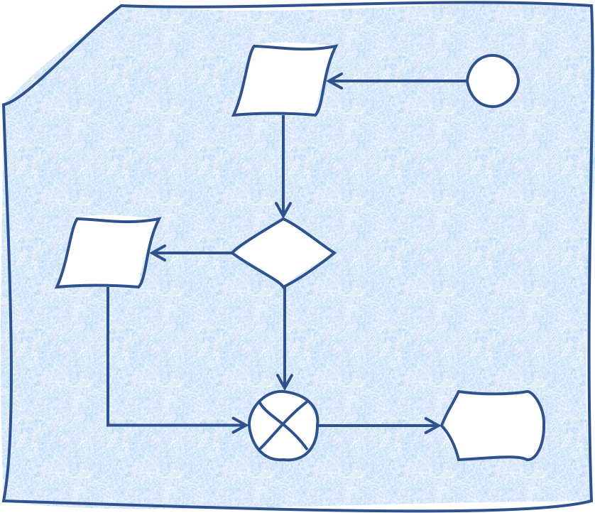

CDS Development Cycle (1 of 2)
CDS traditionally developed via lengthy sequential process
See diagram on left
When new guidelines are released, developers and vendors typically left on own to implement
Results in redundant and inconsistent implementations
A better approach has been proposed
Agency for Healthcare Research and Quality (AHRQ): CDS Connect
CDC: Adapting Clinical Guidelines for the Digital Age Initiative
Current approach (status quo)
Clinical Research
Clinical Practice Guideline (CPG)
CDS (Concept)
CDS (Multiple independent implementations)

Slide 148
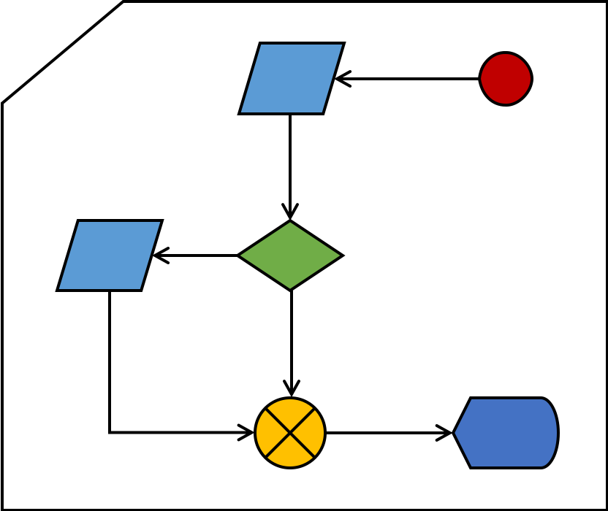
CDS Development Cycle (2 of 2)
Idea: Develop guidelines and CDS in parallel (CDC)
Idea: Express CDS using open health standards (AHRQ)
Alternative approach promises to reduce bench to bedside
Total implementation burden can be reduced
Until open health standards are more widespread, there will still be site/system specific details
Triggers
Data mapping
Alternative Approach
Clinical Research
CPG
CDS (Concept)
CDS expressed using open health standards (e.g., FHIR, CQL, etc.)
System specific
Standards-based
(SMART, CDS Hooks)
System specific
System specific
CDS implementations (less redundancy)

Slide 149
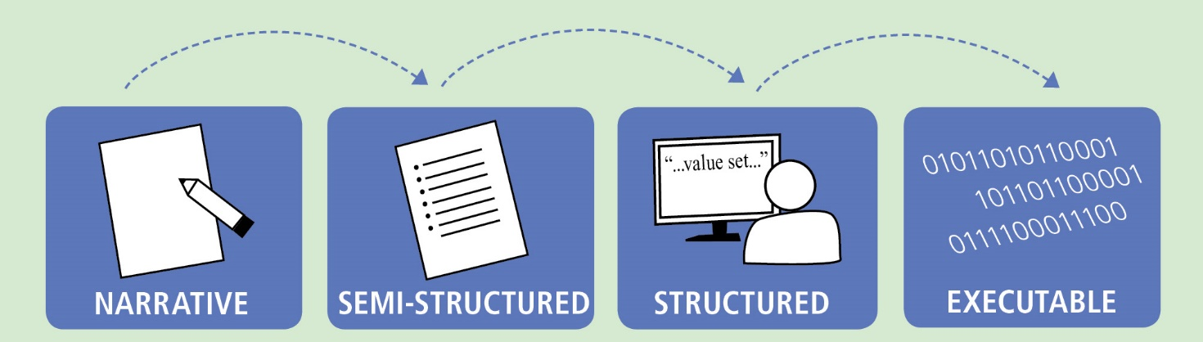
Knowledge Translation Process
Level 1 (or “L1”)
Level 2 (or “L2”)
Level 3 (or “L3”)
Level 4 (or “L4”)
Adapted from: Boxwala, A. A., et al. (2011). "A multi-layered framework for disseminating knowledge for computer-based decision support." Journal of the American Medical Informatics Association : JAMIA 18 Suppl 1: i132-139.

Slide 150

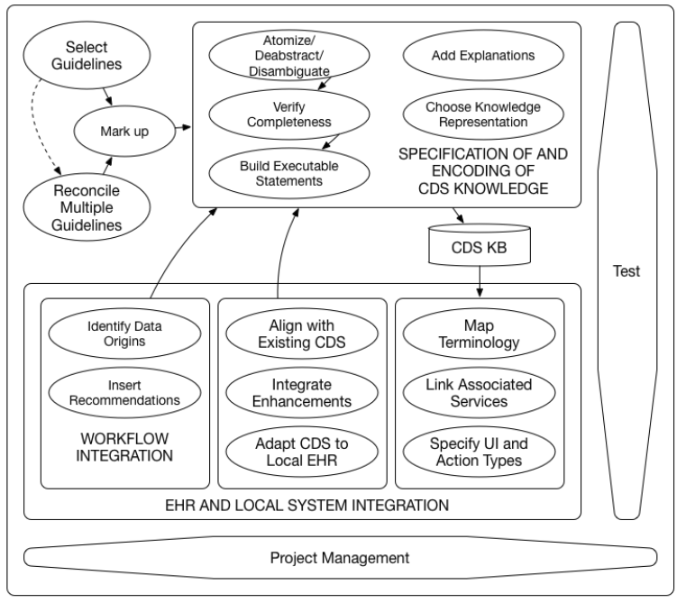



Knowledge Translation Methodology
Knowledge translation involves a series of complex evaluations and activities
“L1”: Evidence-based “source” selection
“L2” and “L3”: Translating and encoding knowledge
“L4”: CDS integration with health IT
Reference: Tso, GJ, Samson TU, Oshiro C, et al. Automating Guidelines for Clinical Decision Support: Knowledge Engineering and Implementation. 2016 AMIA Annual Symposium Proc. 2016: 1189-1198. Available at: https://www.ncbi.nlm.nih.gov/pmc/articles/PMC5333329/

Slide 151
The CDS “5 Rights”
Right information (what)
Evidence-based, pertinent to the situation, suitable to guide action
Right person (who)
Consider all care team members (e.g., clinicians, patients, caretakers)
Right channel (where)
e.g., EHR, PHR, mobile app, email
Right intervention format (how)
e.g. order set, documentation tool, data display, reference information
Right time in workflow (when)
When it is needed to inform a decision or take action
Source:
Osheroff, J.A., Teich, J.A., D. Levick et al. Improving Outcomes with Clinical Decision Support: An Implementer’s Guide. 2nd Edition. Chicago, IL: HIMSS, 2012: p. 15.

Slide 152
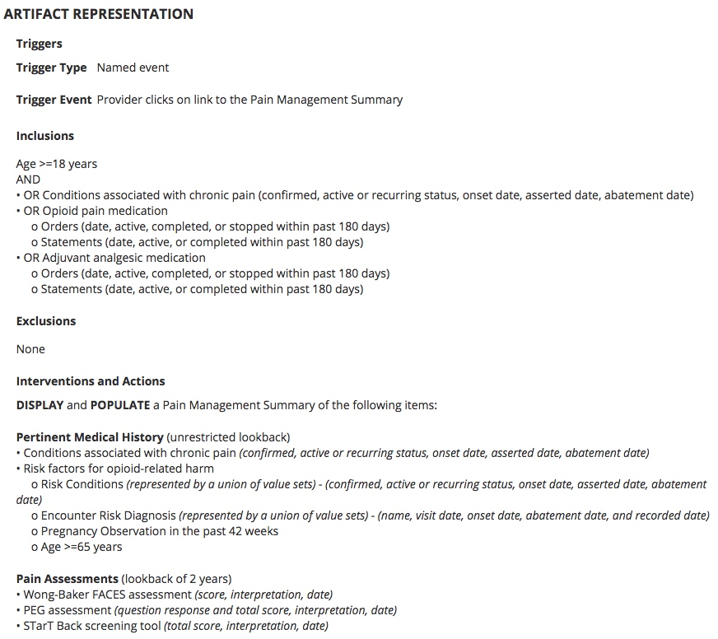
Knowledge Translation Example (1 of 2)
Example adapted from: Lomotan and Moesel, “CDS Connect Pain Management Summary,” U of Washington FHIR Workshop, 12 Sept 2020.
“Before starting, and periodically during continuation of opioid therapy, clinicians should evaluate risk factors for opioid-related harms. Clinicians should incorporate into the management plan strategies to mitigate risk, including considering offering naloxone when factors that increase risk for opioid overdose, such as history of overdose, history of substance use disorder, higher opioid dosages (greater than or equal to [≥] 50 morphine milligram equivalents [MME]/day), or concurrent benzodiazepine use, are present.”
Level 1 / Narrative CDS “Concept”
Level 2 / Semi-structured CDS “Concept”
https://www.cdc.gov/drugoverdose/pdf/prescribing/Guidelines_Factsheet-a.pdf
https://cds.ahrq.gov/cdsconnect/artifact/factors-consider-managing-chronic-pain-pain-management-summary

Slide 153
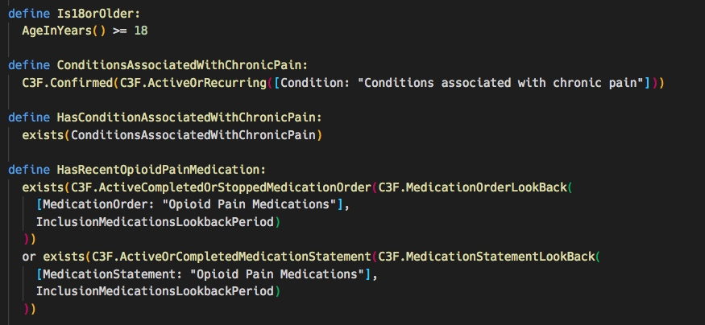
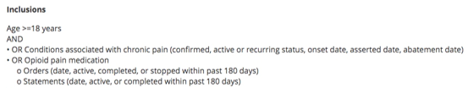
Knowledge Translation Example (2 of 2)
Example adapted from: Lomotan and Moesel, “CDS Connect Pain Management Summary,” U of Washington FHIR Workshop, 12 Sept 2020.
Clinical concepts represented by codes and value sets
Data modeled with Fast Healthcare Interoperability Resources (FHIR)
Logic represented with the Clinical Quality Language (CQL)
Level 2 / Semi-structured CDS “Concept”
Level 3 / Structured CDS “Concept”
https://cds.ahrq.gov/cdsconnect/artifact/factors-consider-managing-chronic-pain-pain-management-summary

Slide 154
Data Rights Notice
NOTICE
This presentation was produced for the U. S. Government under Contract Number 75D30120F09743, and is subject to Federal Acquisition Regulation Clause 52.227-14, Rights in Data-General.
No other use other than that granted to the U. S. Government, or to those acting on behalf of the U.S. Government under that Clause is authorized without the express written permission of The MITRE Corporation.
For further information, please contact The MITRE Corporation, Contracts Management Office, 7515 Colshire Drive, McLean, VA 22102-7539, (703) 983-6000.
© 2022 The MITRE Corporation.

Slide 155



Contact Information
Dr. Mona Saraiya
CDC/DDNID/NCCDPHP/DCPC, yzs2@cdc.gov
Maria Michaels
CDC/DDPHSS/CSELS/OD, ktx2@cdc.gov
Rose Almonte
ralmonte@mitre.org
Dave Winters
dwinters@mitre.org
@MITREcorp
@CDCgov
linkedin.com/company/mitre
linkedin.com/company/centers-for-disease-control-and-prevention

